Slide 1
Quarterly Update on the National Inventory Collaborative
April 3, 2019

Slide 2
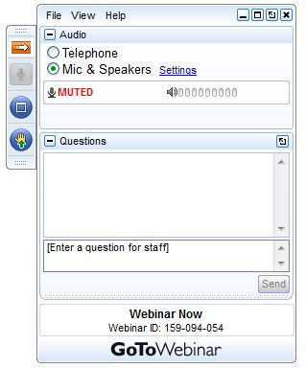
Webinar Ground Rules: Questions?
Each workgroup will give a ~5 minute update describing their work over the last quarter and their plans for the coming months.
All call participants will remain on mute during the webinar.
Type your questions into the question box on the webinar client.
We will try to answer questions at the end of the webinar.
We will create a Q&A document following the webinar and post with the meeting notes on the Collaborative Wiki: http://views.cira.colostate.edu/wiki/wiki/9169

Slide 3
Overview of the Collaborative
A new multi-purpose emissions modeling platform (EMP) based on the 2014 National Emissions Inventory version 2 (2014NEIv2) is needed
  State Implementation Plans, federal analyses
  For the first time, EPA, states, and MJOs are engaging in collaborative EMP development
  The 2016 base year was selected via a collaborative process
Future years selected due to regulatory relevance
  2023 is relevant for Ozone NAAQS moderate areas
    2020 is being created by some states/regions for 2008 O3 NAAQS attainment demonstration modeling
  2028 for regional haze

Slide 4
2016 EMP Schedule
Several versions of 2016 platform will be developed
  Alpha: preliminary version based on 2014NEIv2 for some and 2016 for other key sectors (released Spring, 2018)
    For initial testing of 2016 model runs
    Compatible versions of 2014 and 2015 were also released
    https://www.epa.gov/air-emissions-modeling/2014-2016-version-7-air-emissions-modeling-platforms
  Beta: improved and/or new version of actual 2016 emissions for most sectors (March 2019) and preliminary projected emissions for 2023 and 2028 (to workgroups in April 2019)
  V1.0: fully updated 2016 emissions and complete projected emissions for 2023 and 2028 (Summer 2019)

Slide 5
Organizational Structure
Coordination co-leads: Zac Adelman (LADCO) and Alison Eyth (EPA OAQPS)
  Developed process and communication structures, facilitate discussions, help resolve issues, documentation requirements, coordinate distribution of data to stakeholders
Coordination committee: regional, state, EPA leaders
  Define processes, resolve issues, co-lead workgroups
  Includes overall and WG co-leads plus MJO directors
Sector-specific Workgroups: one regional/state staff and one EPA staff (where possible)
  Focus on preparing emissions estimates for 2016 and future years, plus improve how the emissions sectors are modeled
  Include participants from EPA/states/locals/regions

Slide 6
Objectives of Today’s Webinar
Summarize the 2016 beta platform release and data
Present the plans for the version 1 release, including data updates and schedule
Webinar Outline
  2016 beta release summary and download tutorial
  2016 beta emissions summaries
  2016 beta platform next steps
  Collaborative workgroup reports
  Collaborative next steps and plans for the next quarter

Slide 7
2016 beta Release
Release Date: March 13, 2019
  http://views.cira.colostate.edu/wiki/wiki/10197
  AQM-ready data and all SMOKE inputs are available from the Intermountain West Data Warehouse (IWDW)
2016 beta base year release contents
  2016 inventories for all anthropogenic sectors
  2016 inventories for fires
  2016 MEGAN and BEIS3 biogenic emissions
  CMAQ and CAMx-ready emissions at 36km and 12km
  SMOKE ancillary data and scripts for 2016
  Documentation
  Interactive charts and maps at IWDW
  Static charts and maps at LADCO

Slide 8
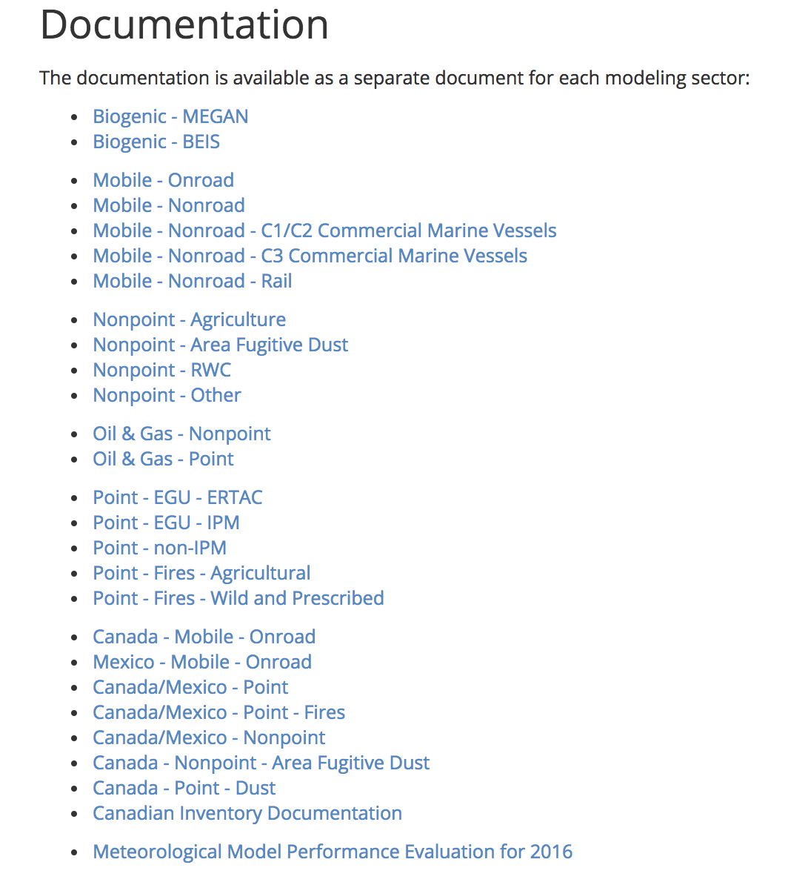
2016 beta Release Documentation
Specification Sheets
27 documents in a standardized format
Describe sector, the SCCs/sources included in the sector, sources of data, processing methods
Graphical and tabular summaries of the data

Slide 9
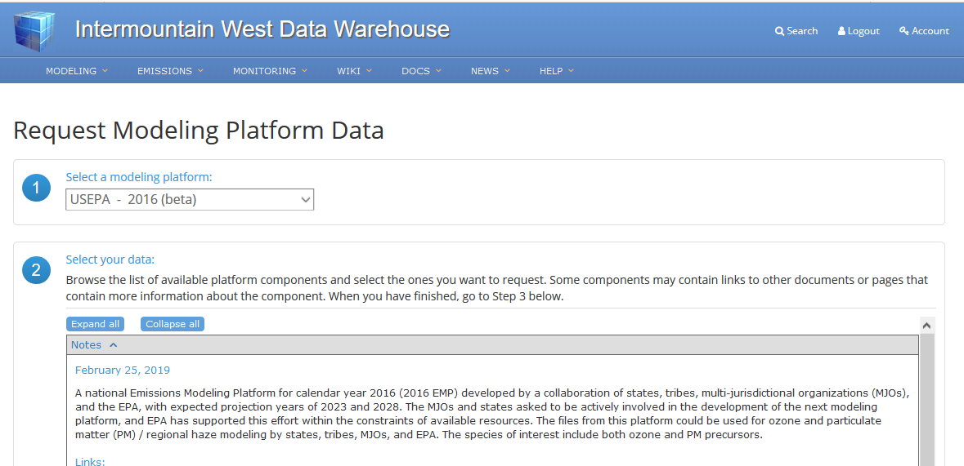
Downloading from IWDW
Once you create an account, you can log in to submit a data request

Slide 10
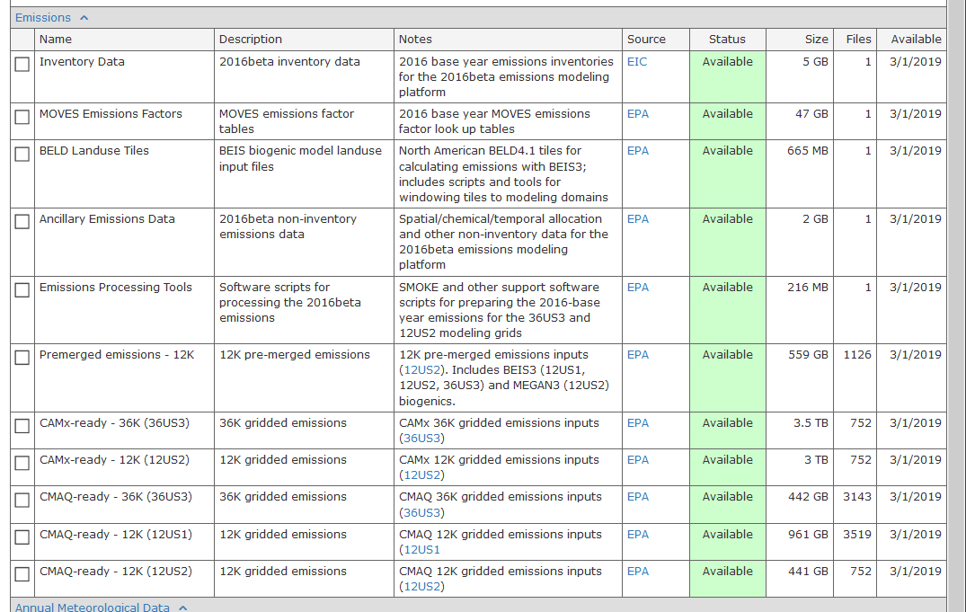
Downloading from IWDW
Select the components you need

Slide 11
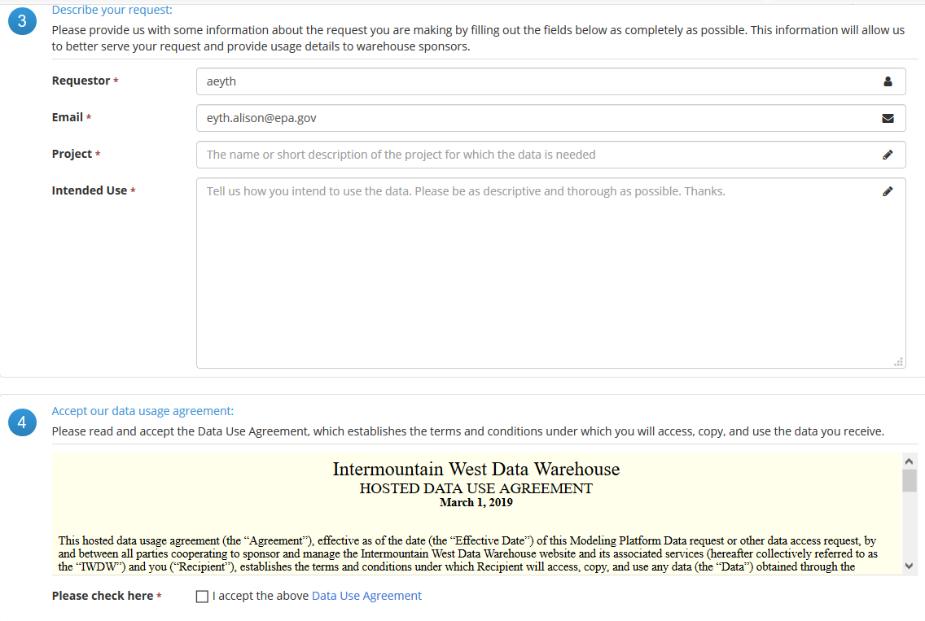
Downloading from IWDW
Enter the remaining information and Submit your request
An IWDW staff member will follow up with you to fulfill the request

Slide 12
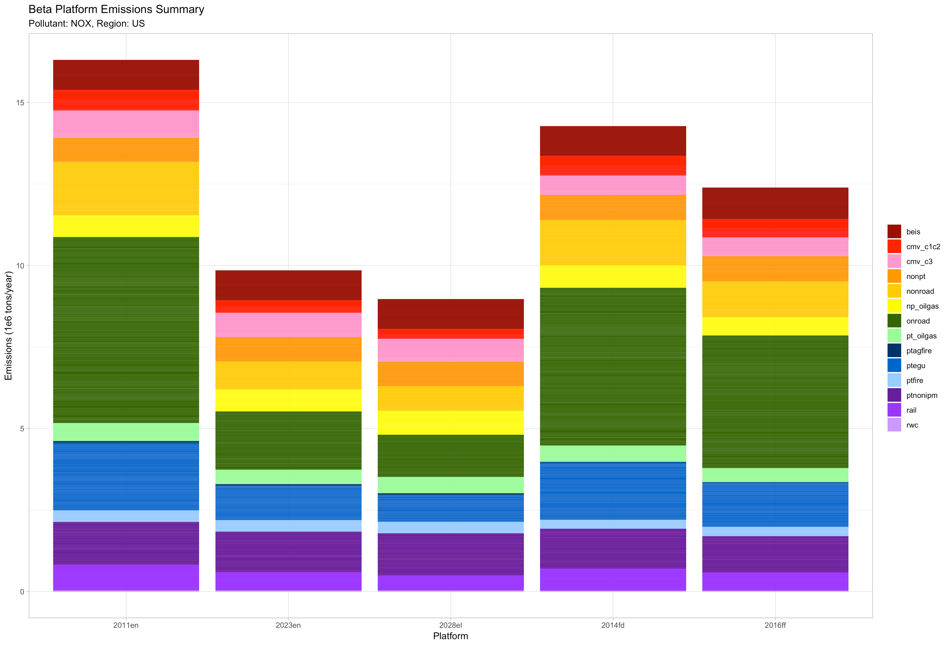
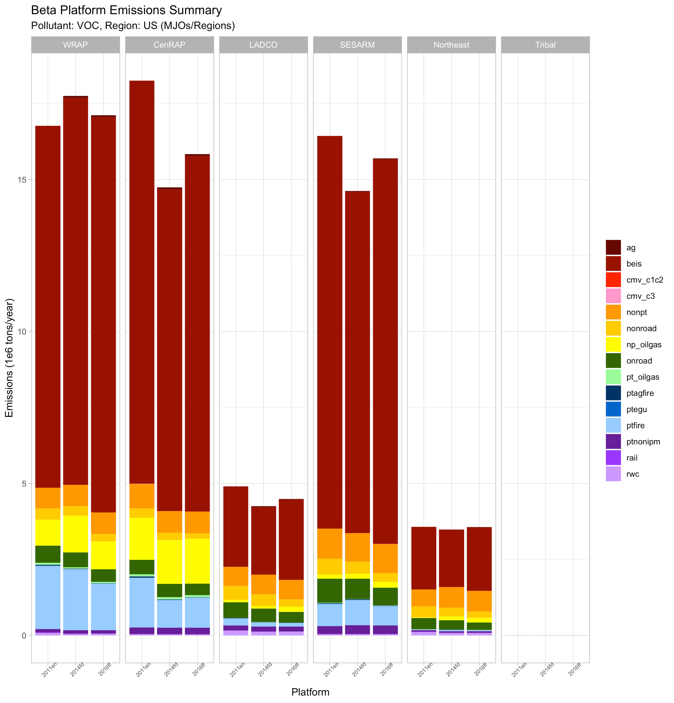
National NOx Emissions by Sector
2011v6 2023₂₀₁₁ 2028₂₀₁₁ 2014 2016beta
Notes:
Overall the 2016beta NOx inventory is lower in 2016beta than both 2011 (-20.4%) and 2014 (-10.6%). Declining emissions from most sectors moving from 2011 to 2016; largest changes in onroad mobile (-28.8%), nonroad mobile (-33%), and EGU point (-34.6%); increasing emissions in nonpoint (5%) and biogenic NO (5.9%)

Slide 13
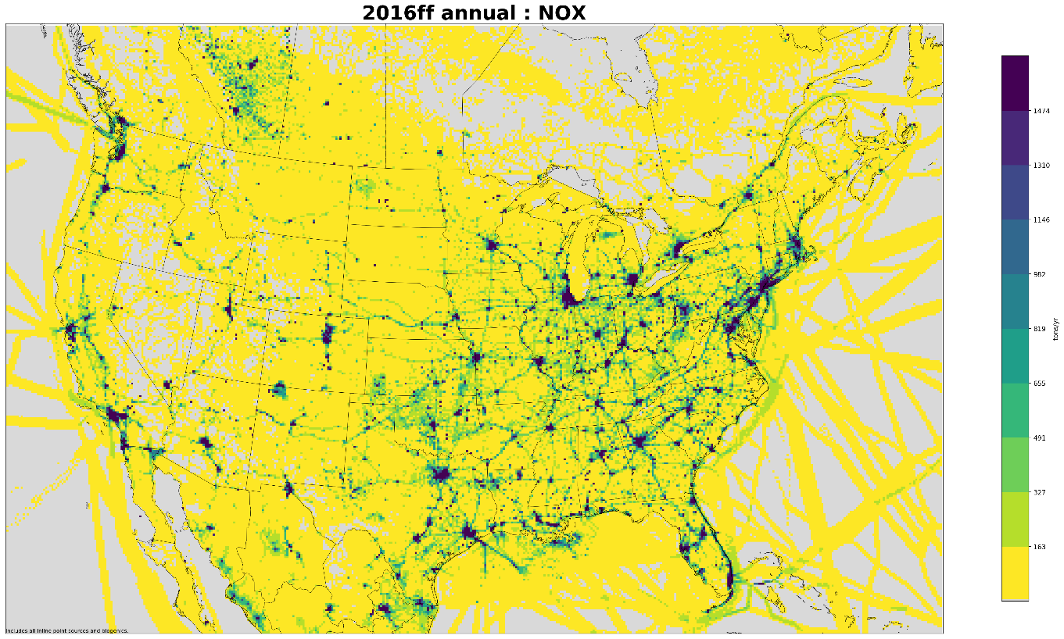
2016 Annual 12-km Gridded NOx Emissions (tons/year)
Notes:
Roadways and urban areas present NOx emission hotspots, can also see some fires and large point sources

Slide 14
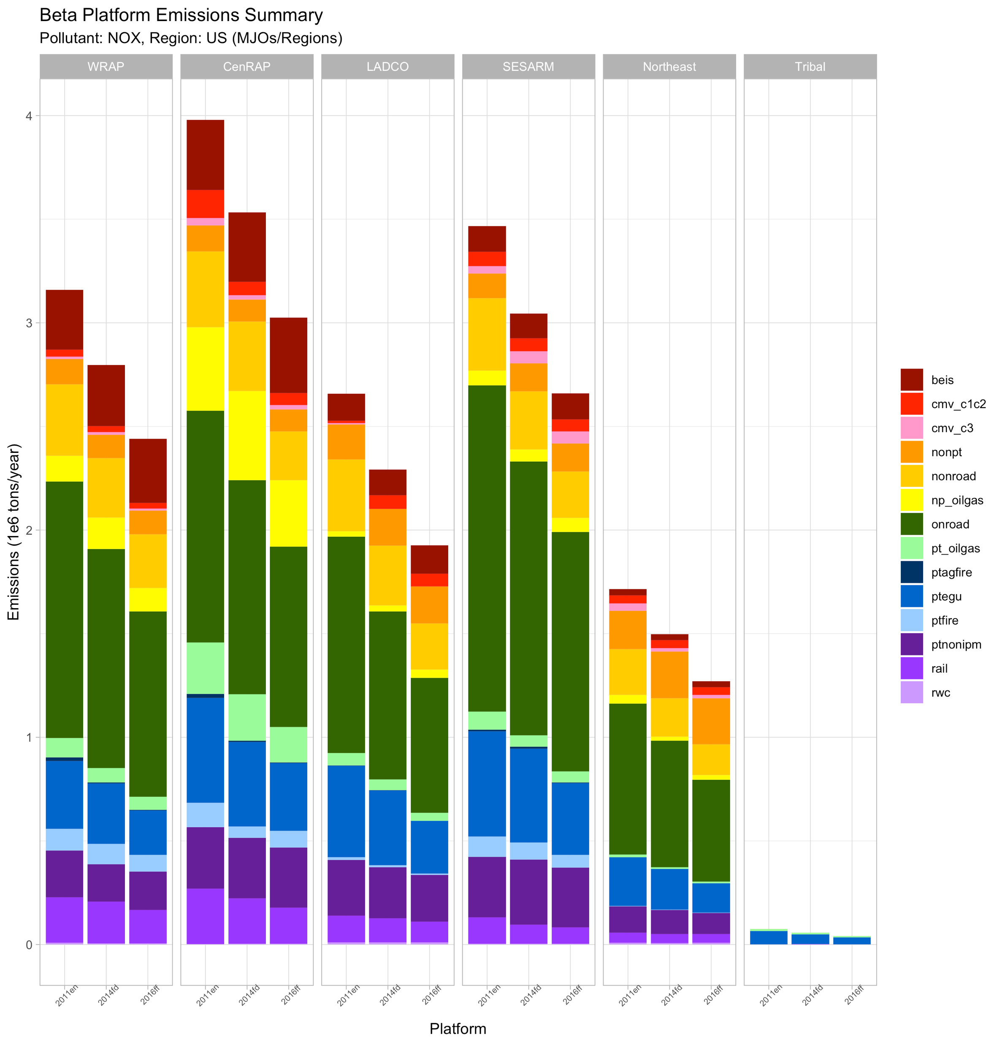
Regional NOx Emissions by Sector
Regional comparisons of 2011, 2014, and 2016
All regions have declining onroad and nonroad mobile, EGU point, and rail
Oil&Gas declines in WRAP, CenRAP, and SESARM

Slide 15
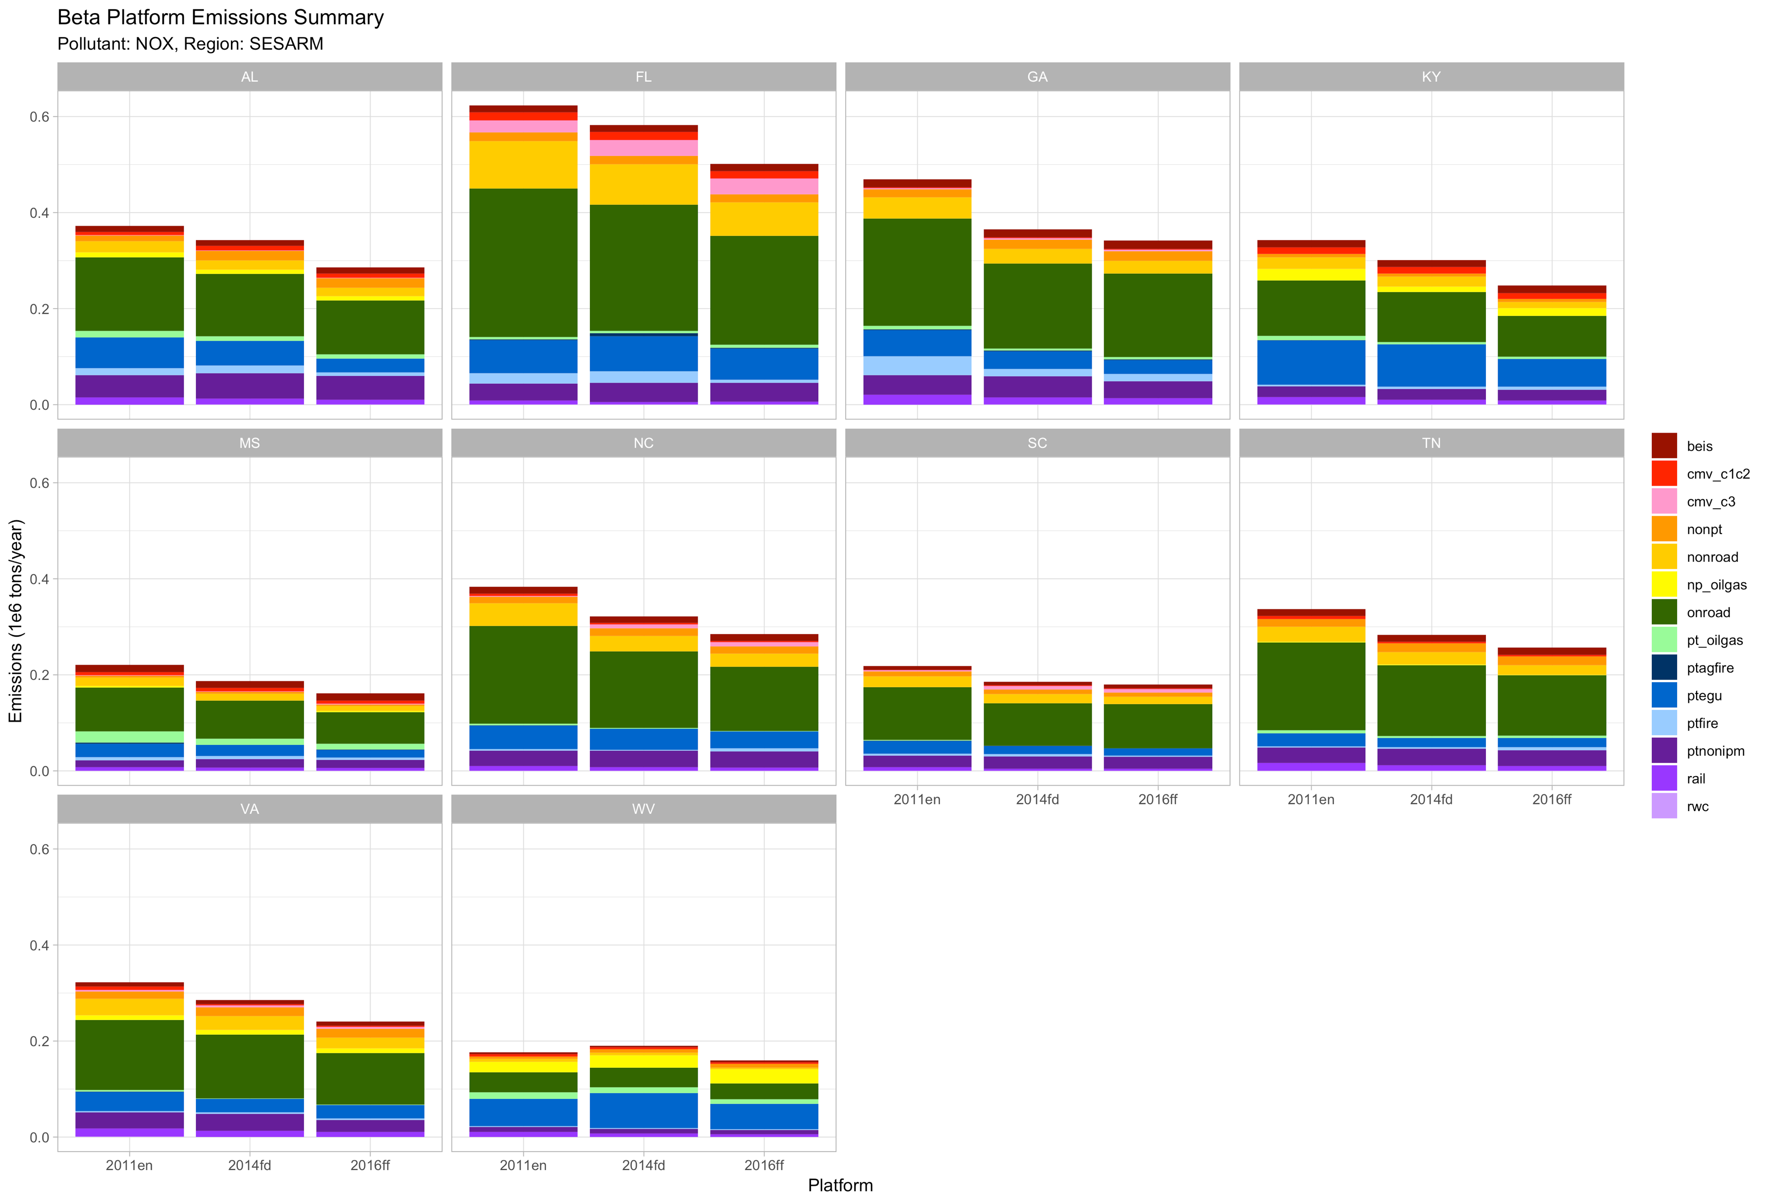
SESARM State NOx Emissions by Sector
AL, GA, KY have the largest reductions in EGU point
FL with largest onroad/nonroad mobile reductions

Slide 16
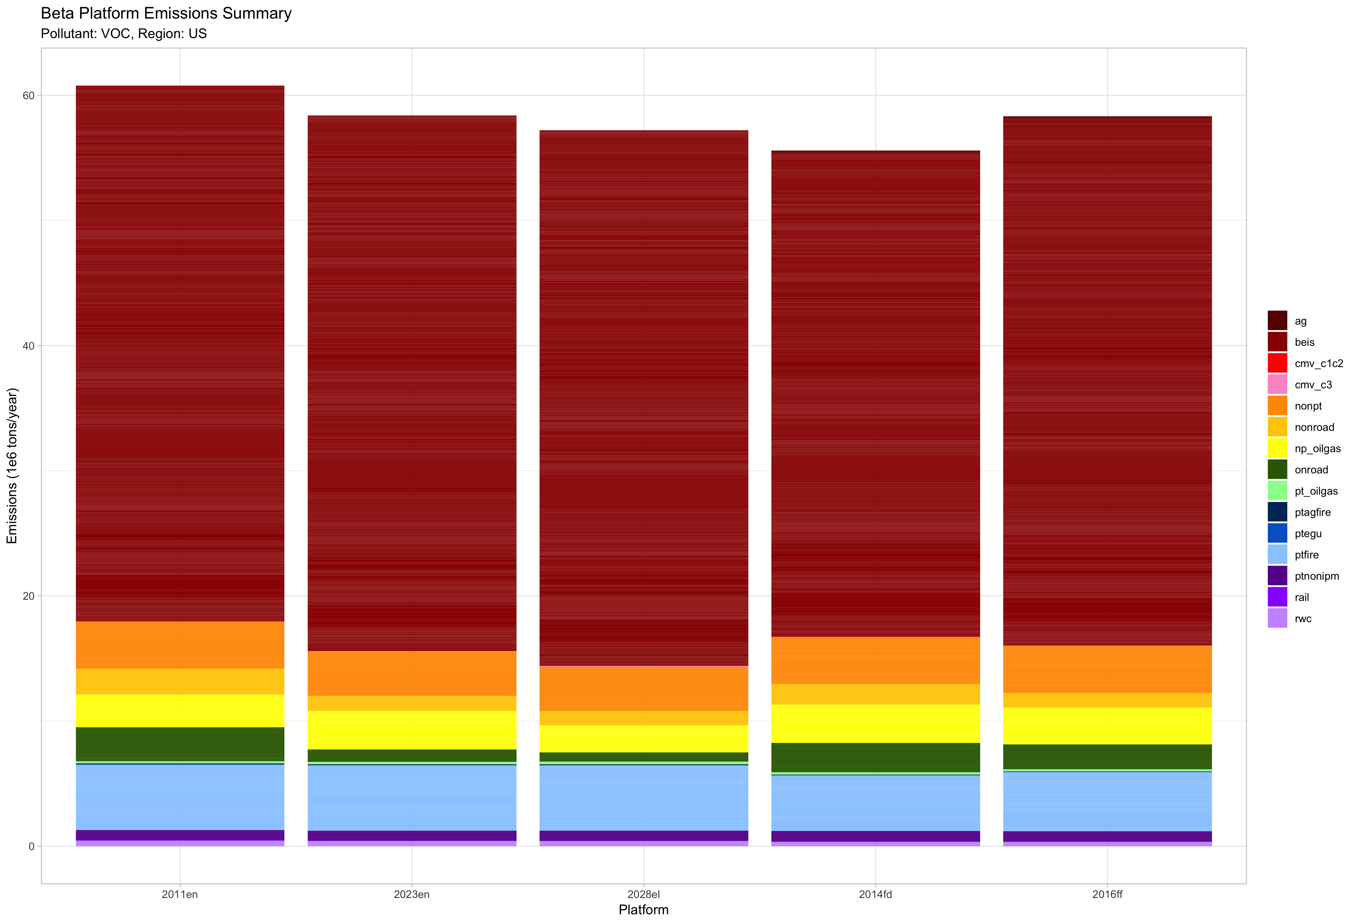
National VOC Emissions by Sector
2011v6 2023₂₀₁₁ 2028₂₀₁₁ 2014 2016beta
Notes:
Overall VOC is lower in 2016 relative to 2011 (-4%), but higher than 2014 (4.9%); anthropogenic VOC is down in 2016 compared to both 2011 (-9.7%) and 2014 (-7.8%); VOC is dominated by biogenic, and the higher biogenic VOC in 2016 relative to 2014 (8.9%) offsets the reductions in other sectors: onroad/nonroad mobile (-21.1%); increase in nonpoint oil & gas from 2011 (12%), but decrease relative to 2014 (-4.1%)

Slide 17
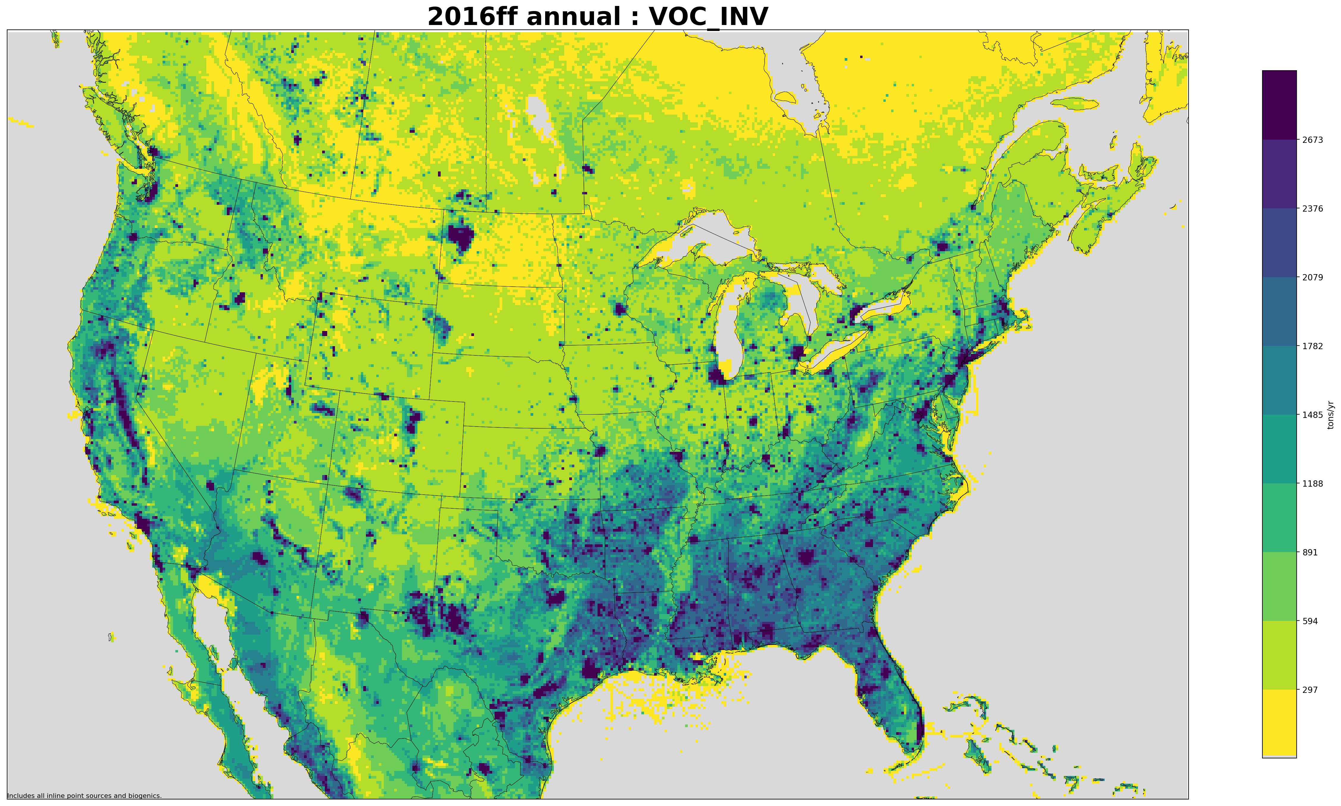
2016 Annual 12-km Gridded VOC Emissions (tons/year)
Notes:
Biogenic emissions in the southern and northwest regions; oil and gas in TX, OK, PA and intermountain west

Slide 18
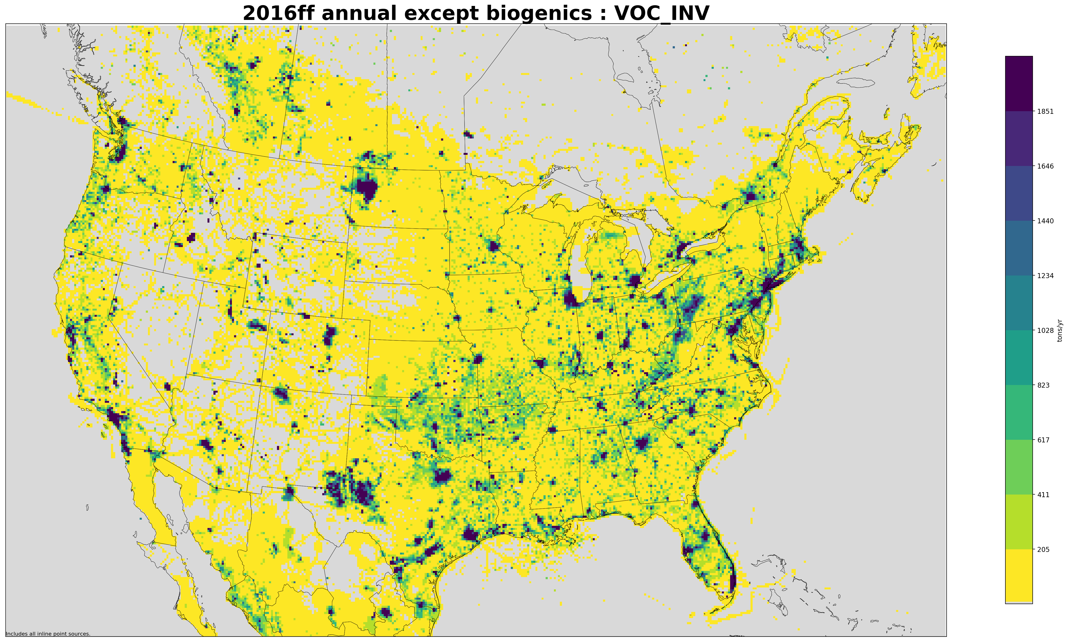
2016 Annual 12-km Gridded VOC* Emissions (tons/year)
*Anthropogenic only
Notes:
Highlights oil and gas, urban areas, and fires (see eastern KS)

Slide 19
Regional VOC Emissions by Sector
Biogenic signal dominates regions with states in the lower US latitudes, and west coast
2014 → 2016 increase in biogenic VOC driven by meteorology: 2016 was warmer than 2014 in the Eastern half of the country
Increasing nonpoint oil&gas across all of the regions relative to 2011

Slide 20
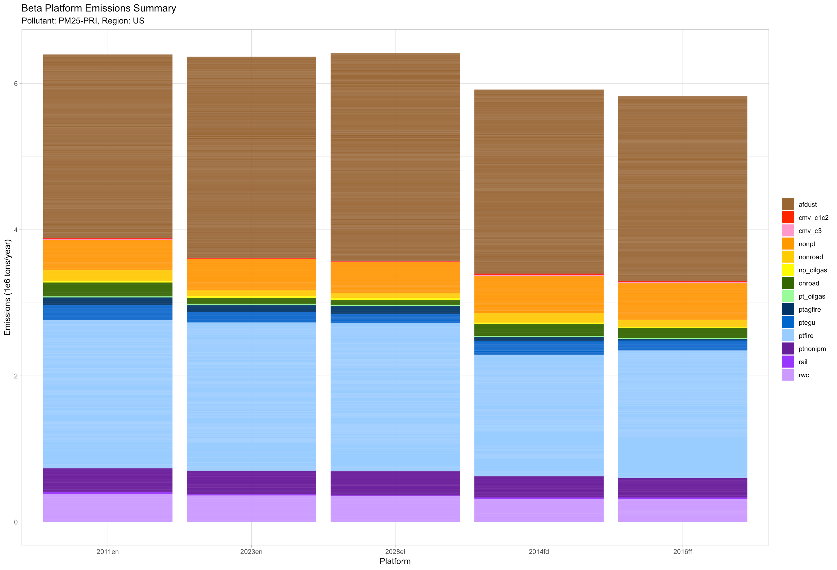
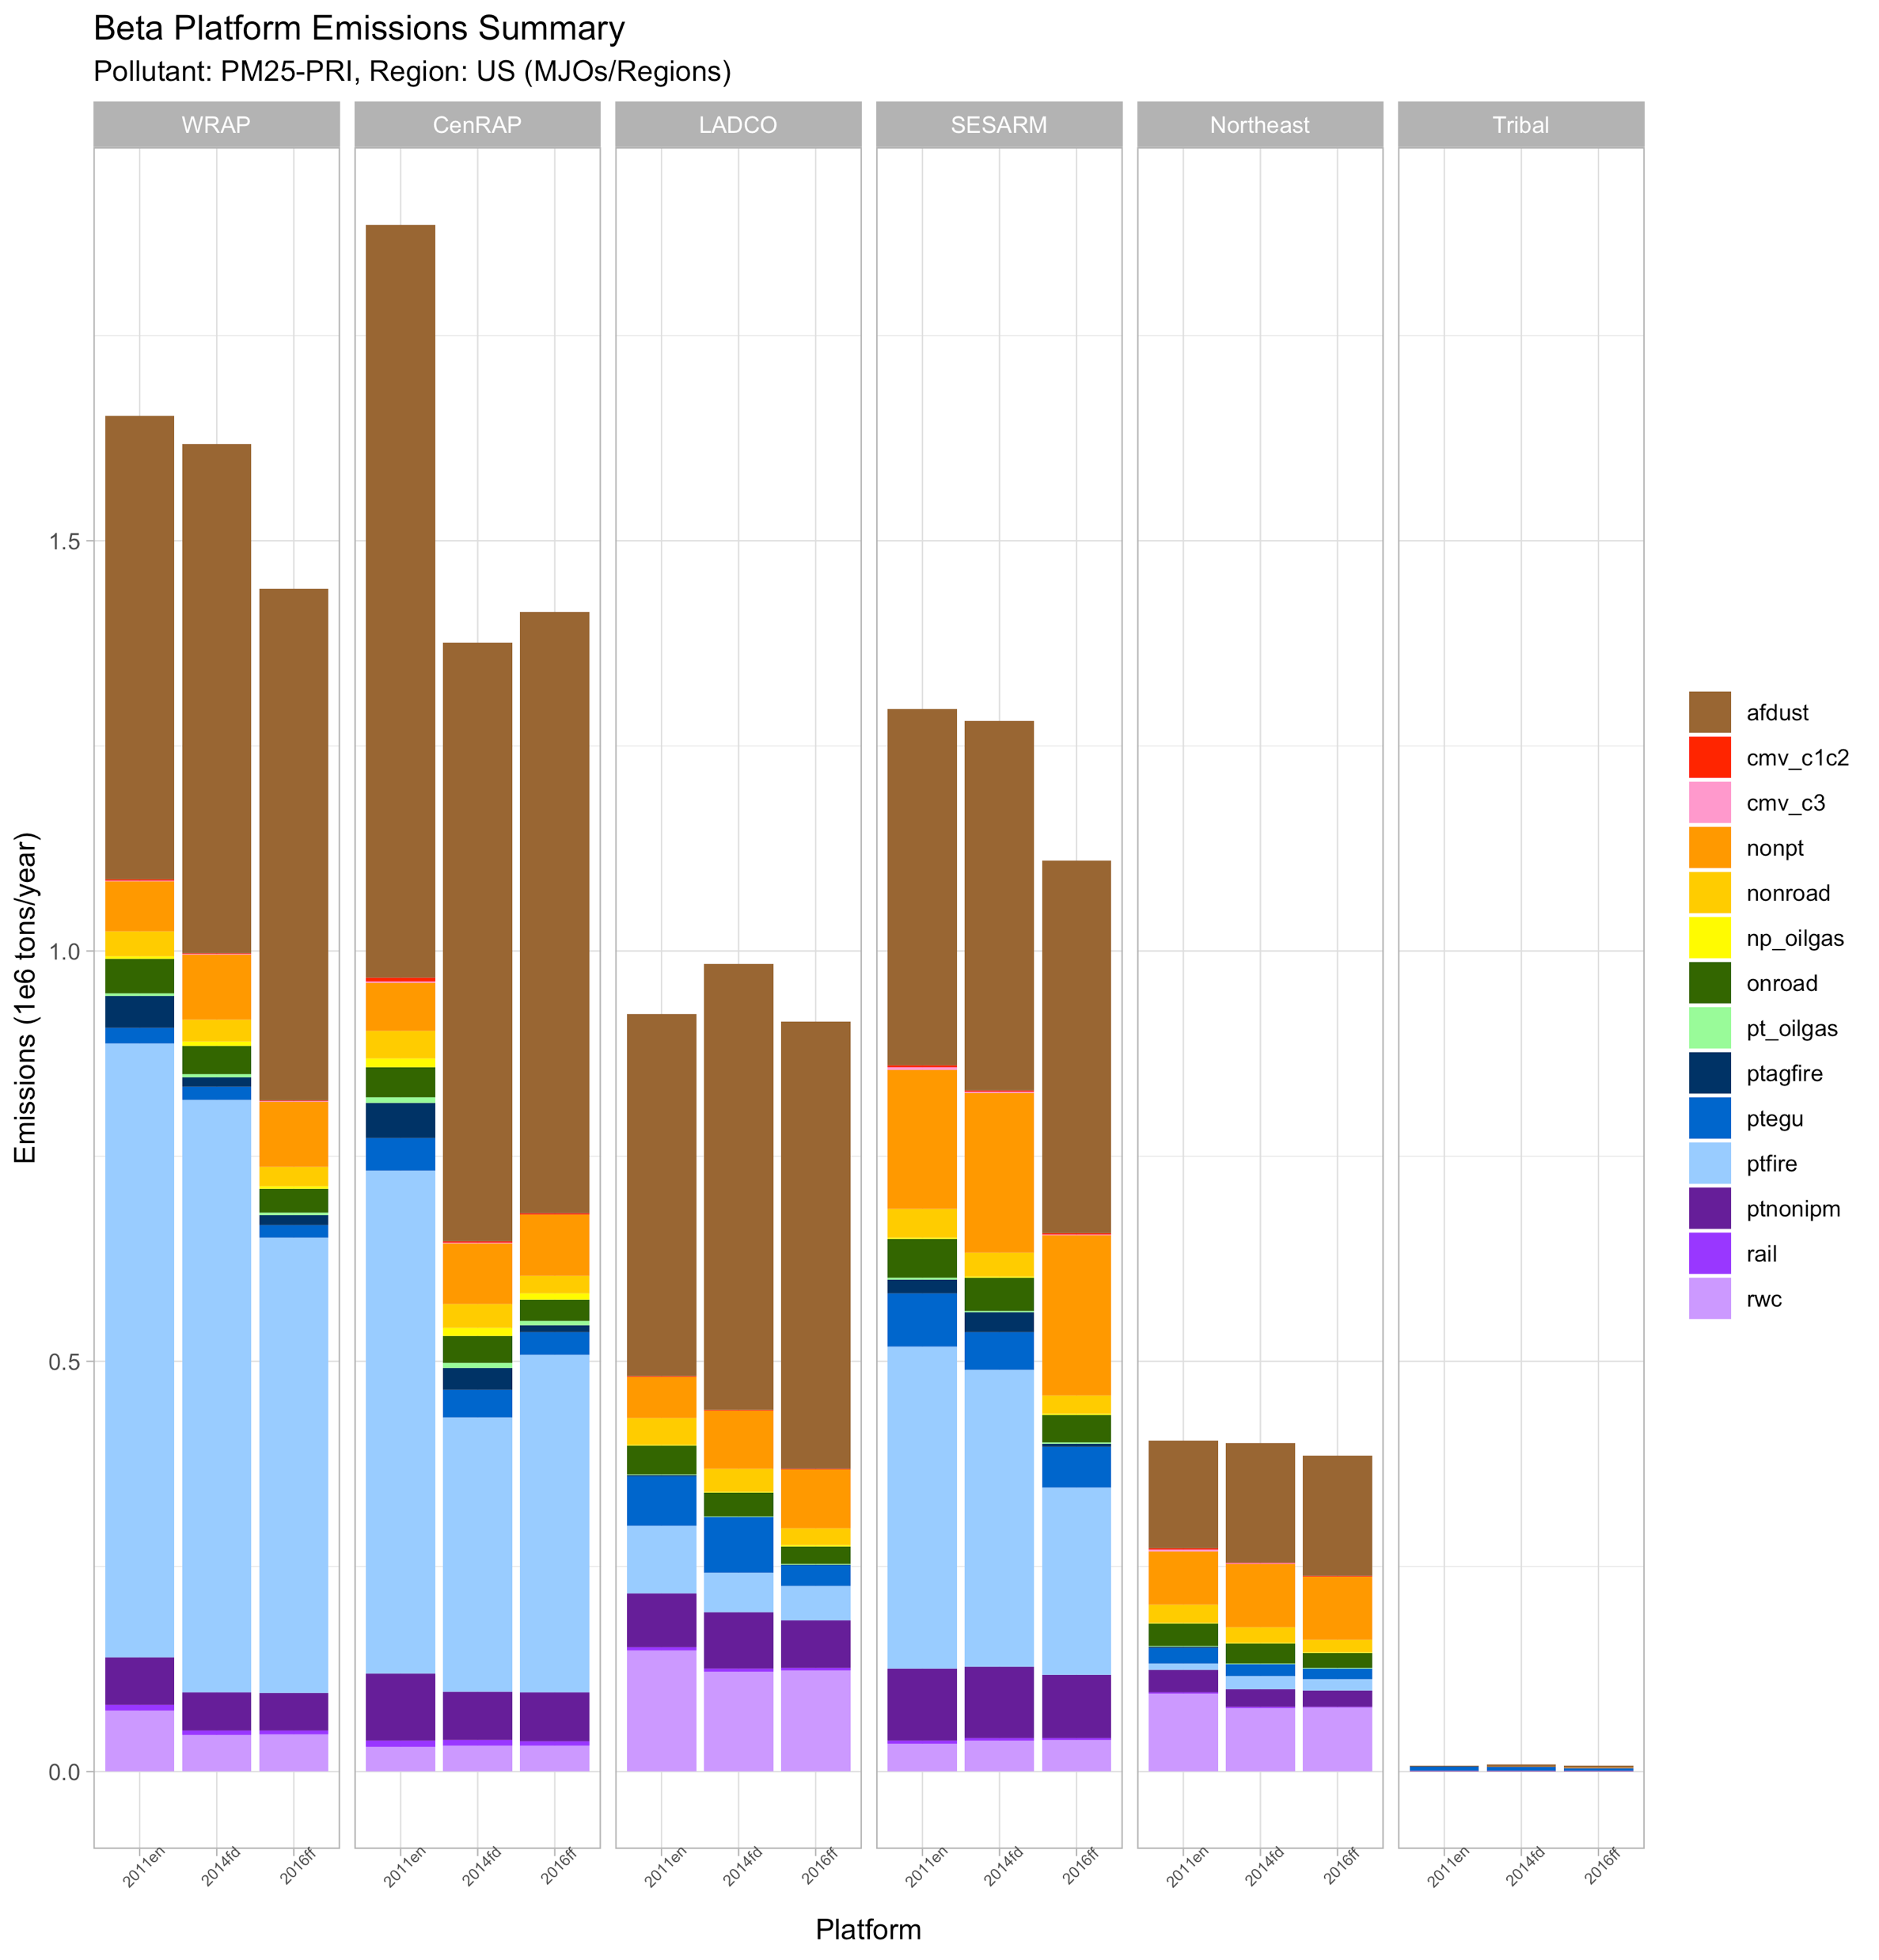
National PM_{2.5} Emissions by Sector
2011v6 2023₂₀₁₁ 2028₂₀₁₁ 2014 2016beta
Notes:
Overall national PM2.5 emissions are lower in 2016 than both 2011 (8.9%) and 2014 (1.3%); afdust, the largest contributor to national PM2.5 is slightly higher in 2016 than 2011 (0.8%) and 2015 (0.5%)

Slide 21
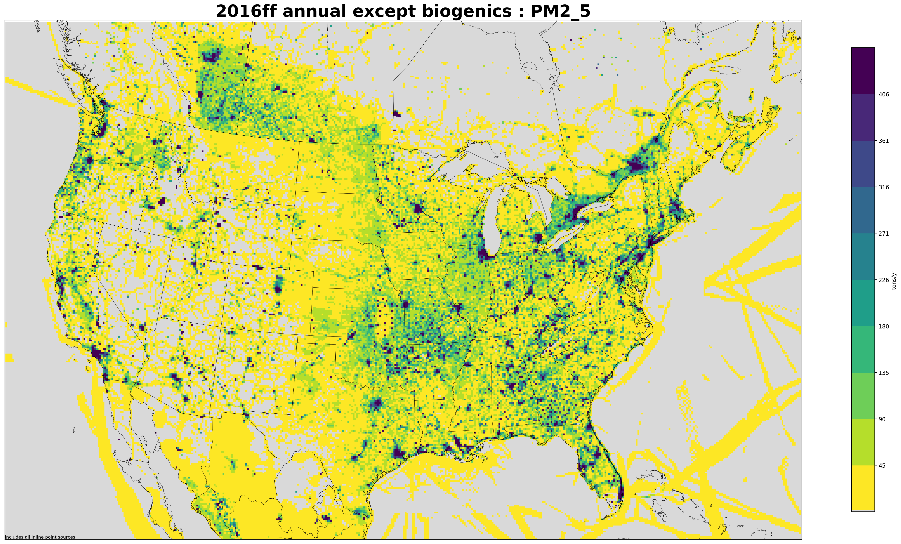
2016 Annual 12-km Gridded PM_{2.5} Emissions (tons/year)

Slide 22
Regional PM_{2.5} Emissions by Sector
Changes to PM2.5 in 2016 relative to past inventories are driven by point fire, ag fire, RWC, non-EGU point
Reduction in point fire PM2.5 in the CenRAP region from 2011 to both 2014 and 2016 have a big influence on the national totals

Slide 23
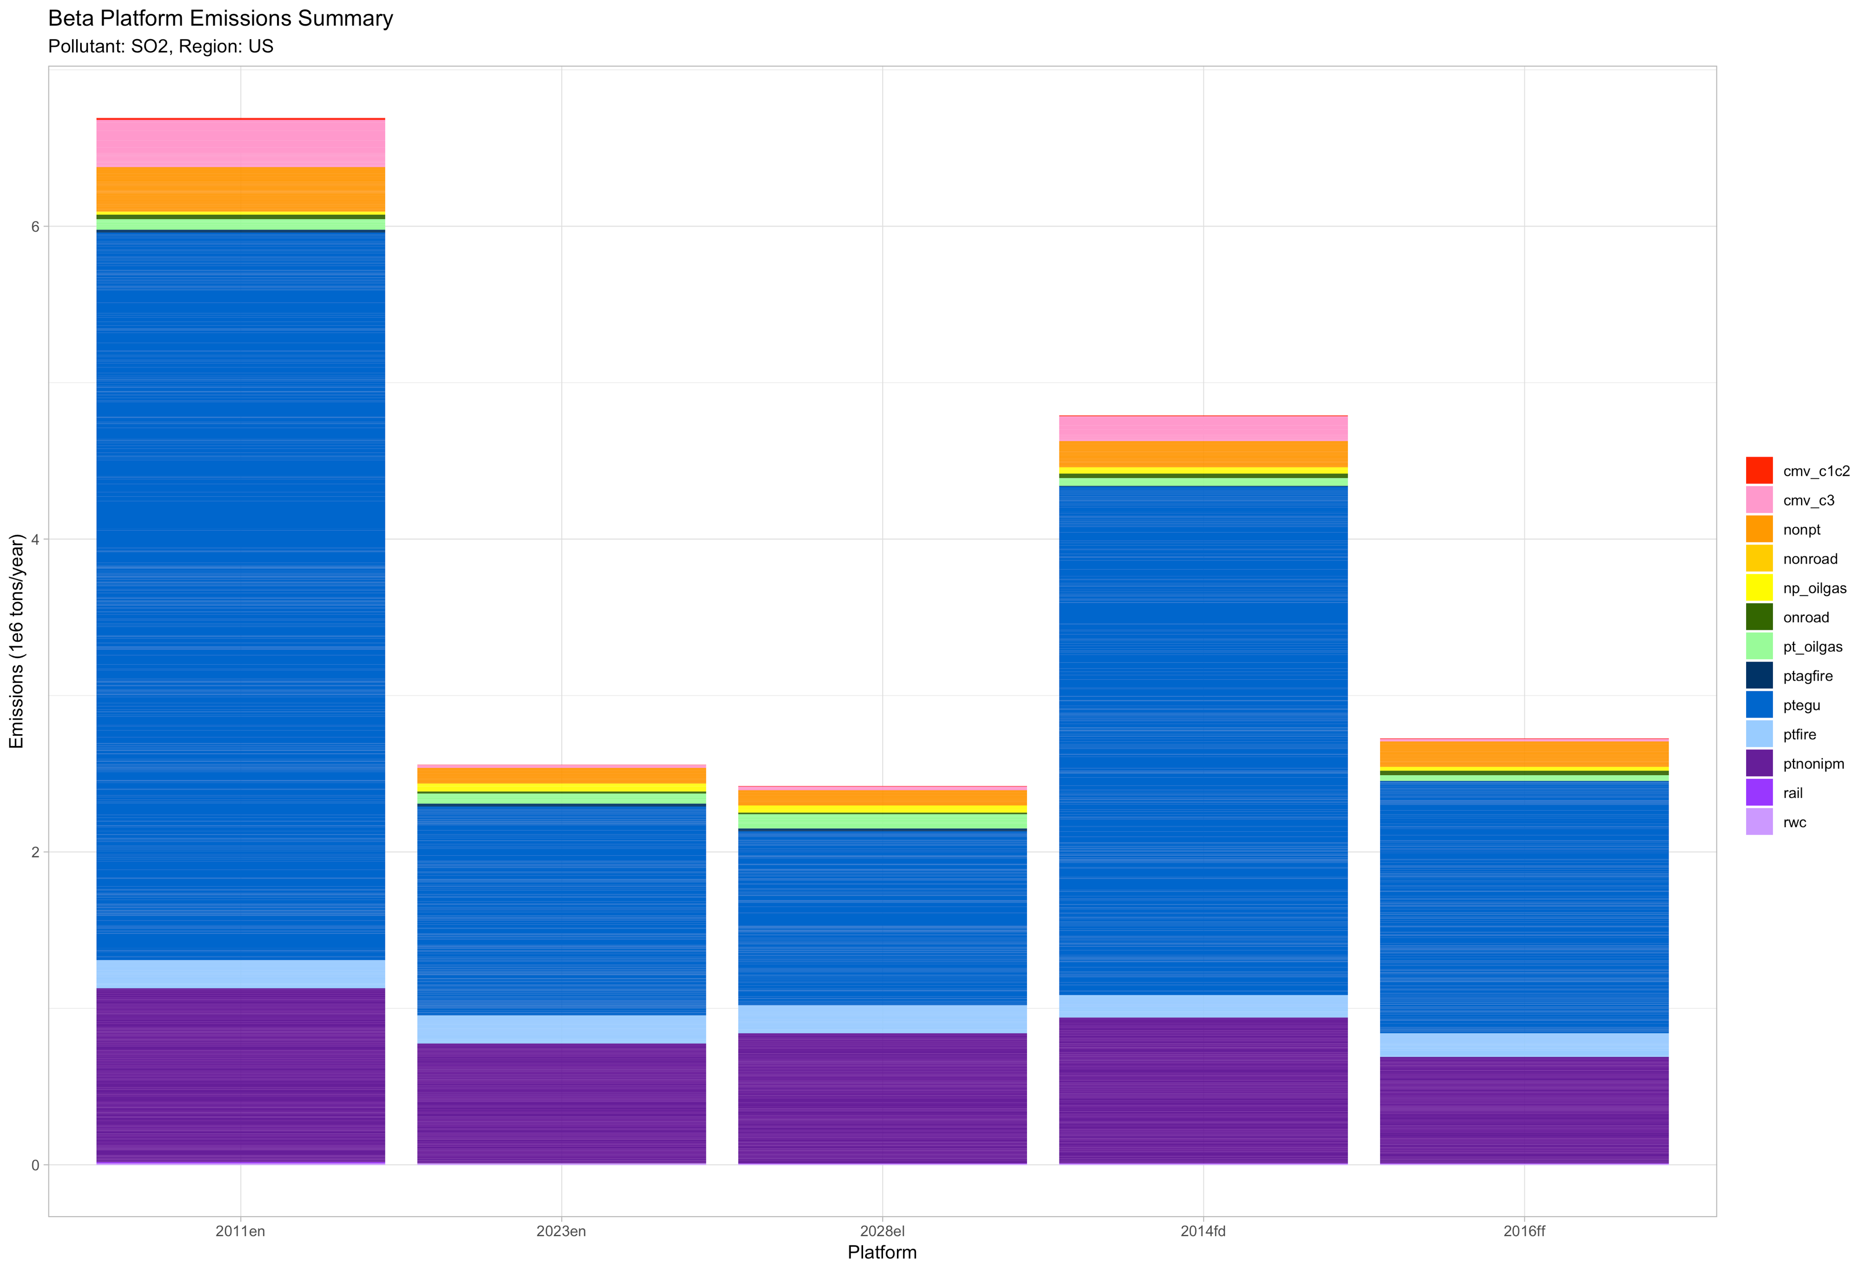
National SO₂ Emissions by Sector
2011v6 2023₂₀₁₁ 2028₂₀₁₁ 2014 2016beta
Notes:
Overall SO2 emissions are lower in 2016beta the 2011 (-48%) and 2014 (32.1%); these changes are driven primarily by EGU point, with decreases from 2011 (-65.4%) and 2014 (50.5%); non-EGU point also decreases from 2011 (-38.8&) and 2014 (-27.1%)

Slide 24
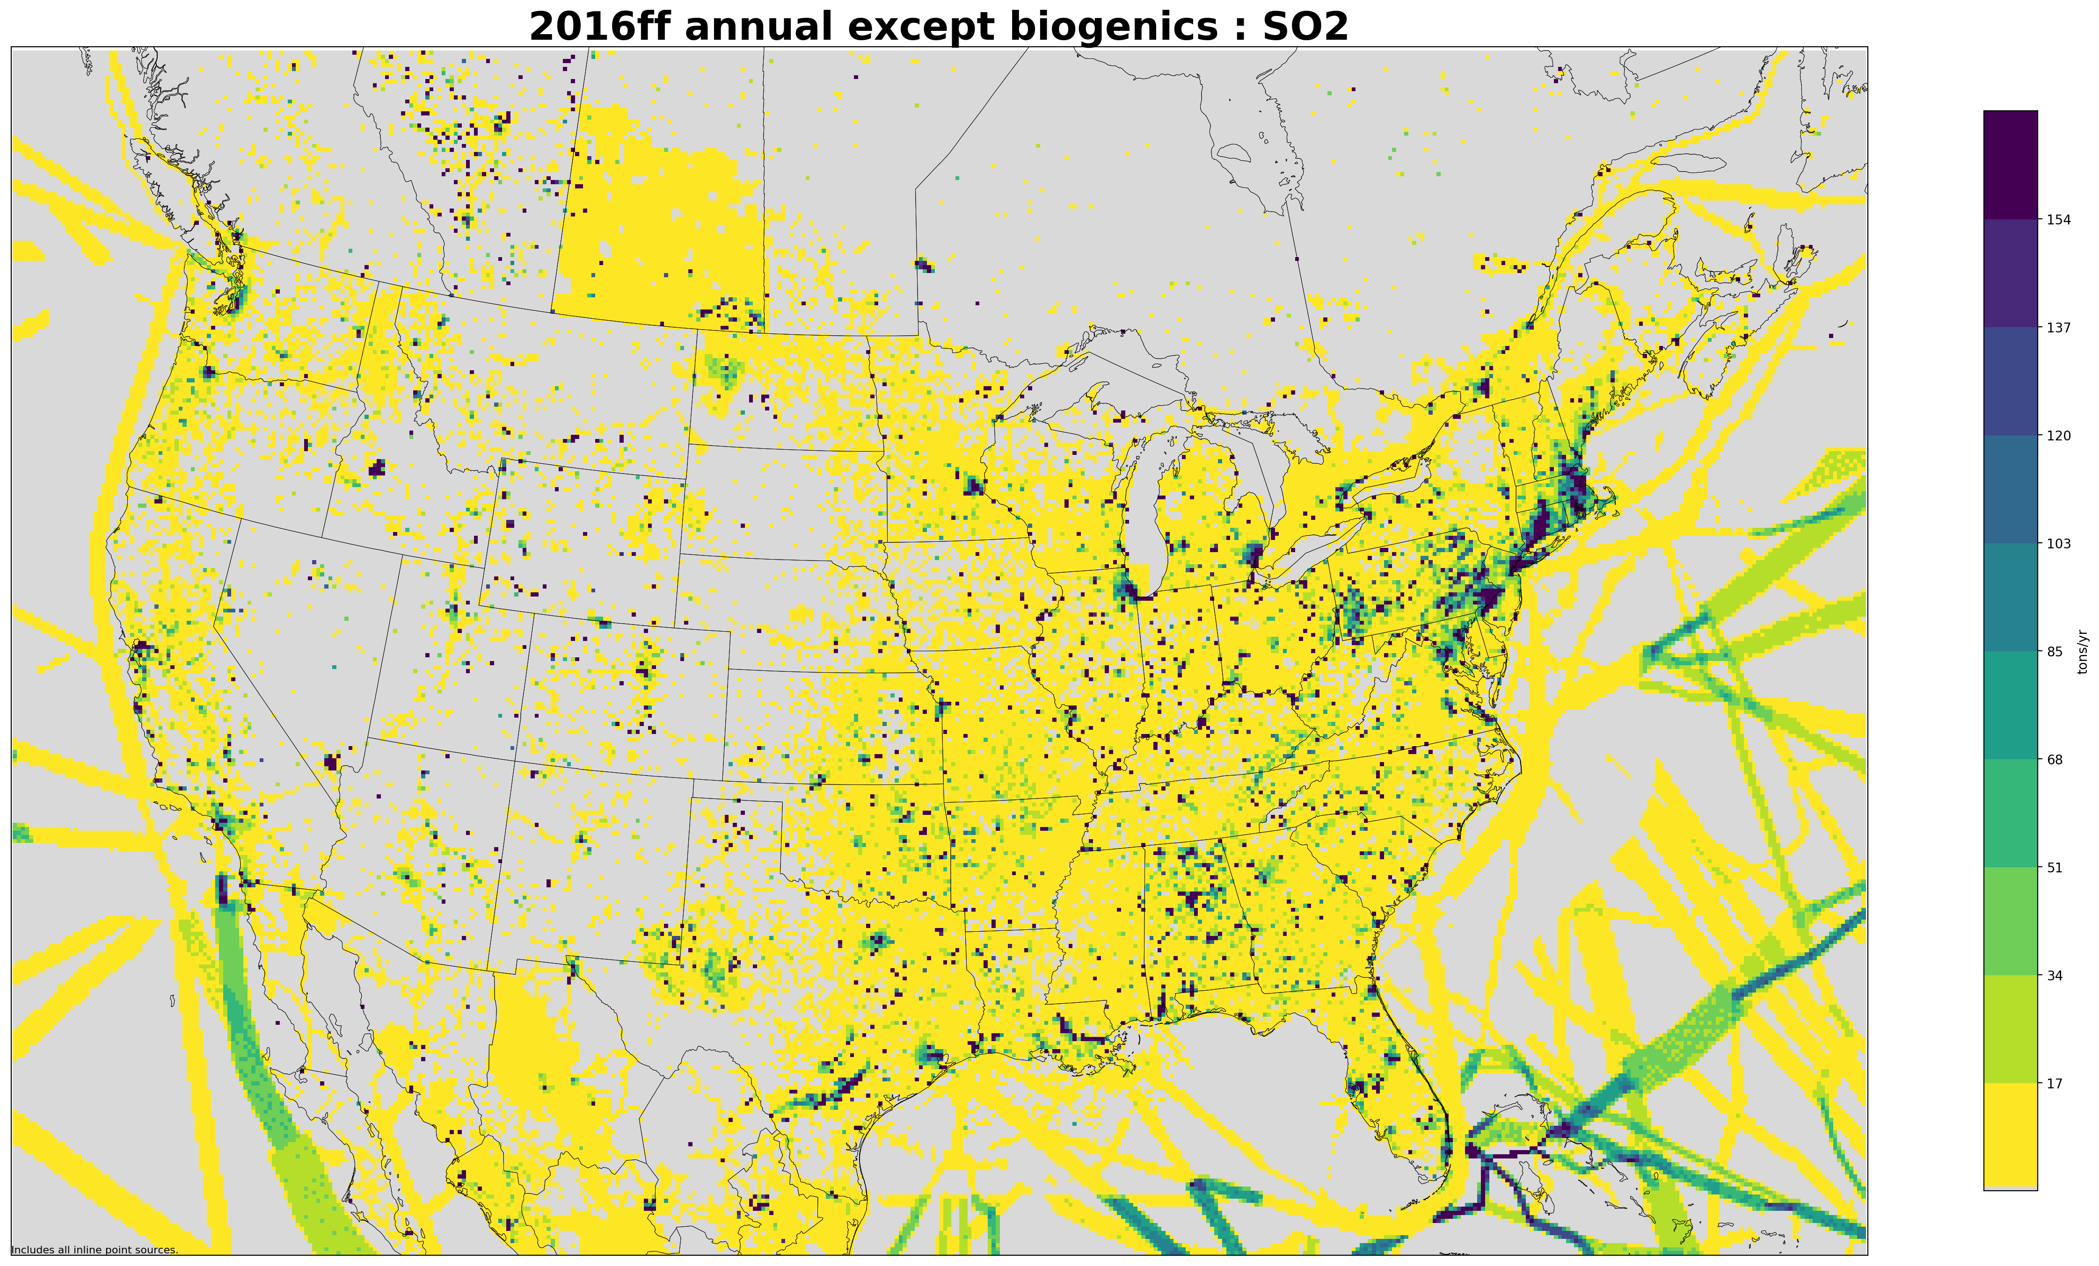
2016 Annual 12-km Gridded SO₂ Emissions (tons/year)
Notes:
EGU point sources are highlighted as the dark cells; the impacts of the SECA reduction zone is seen in the offshore sources with a clear boundary at the federal waters boundary (higher SO2 emissions beyond the boundary)

Slide 25
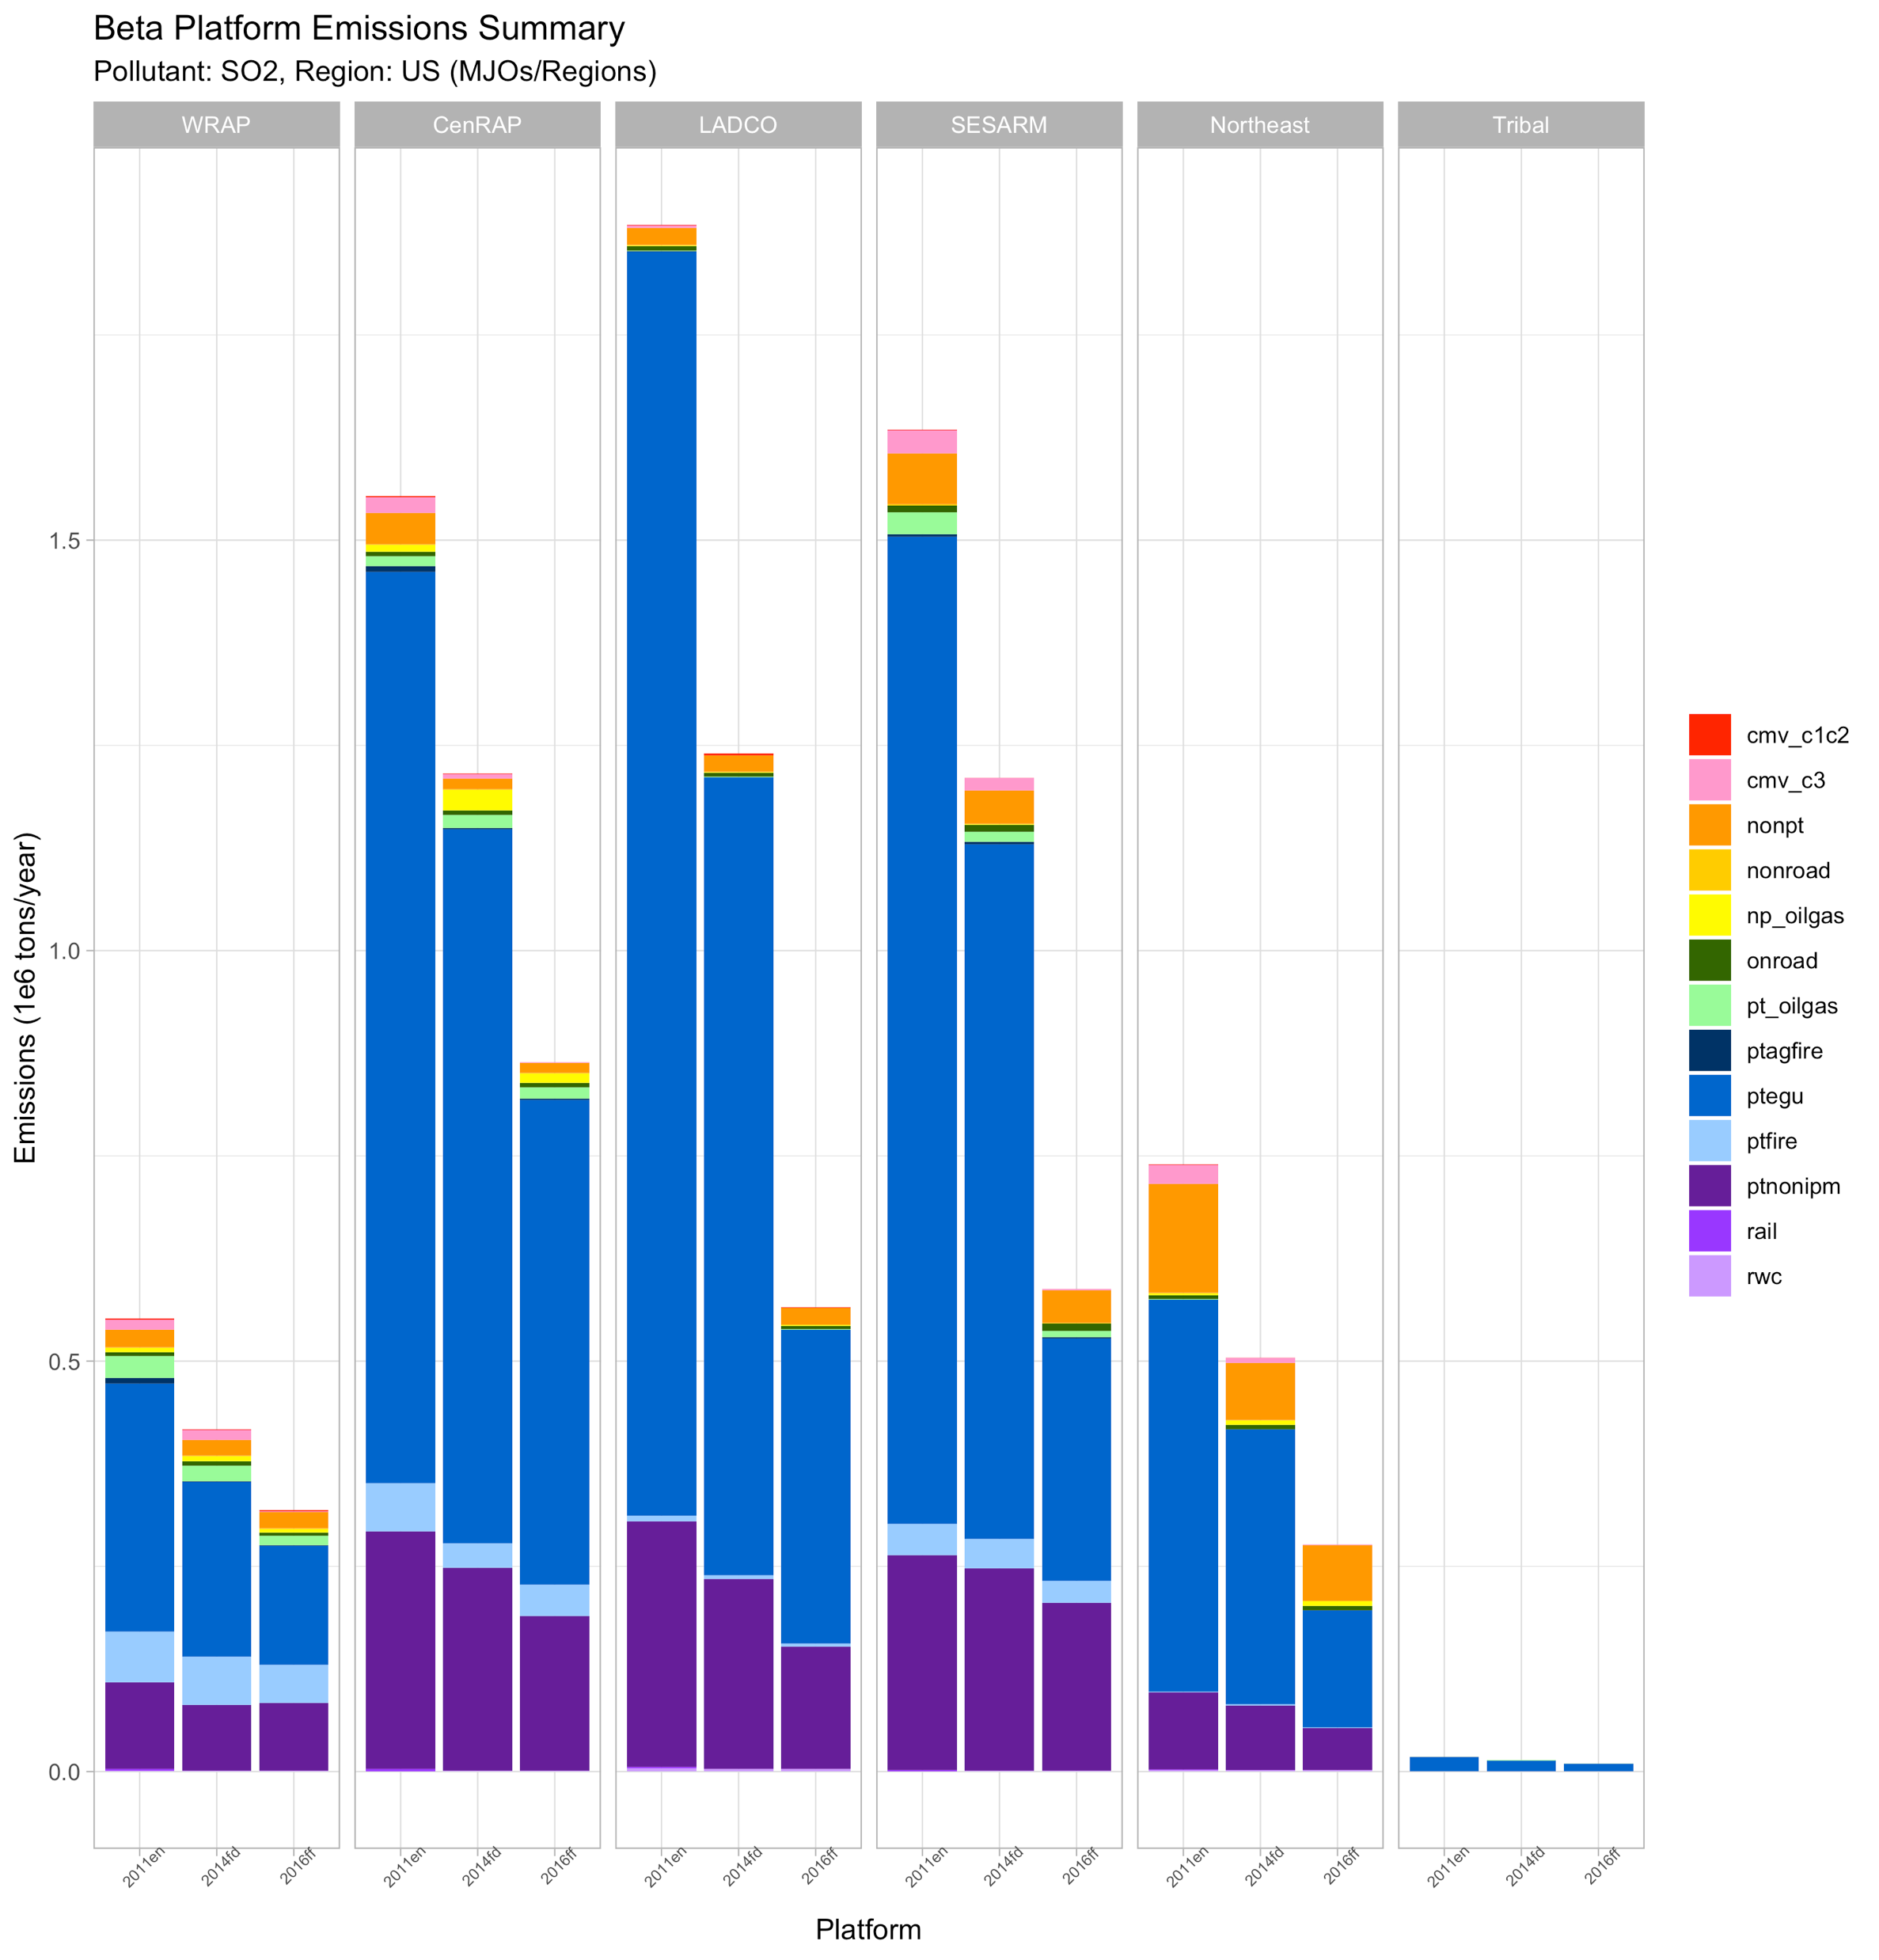
Regional SO₂ Emissions by Sector
LADCO and SESARM region EGU and non-EGU point SO2 emissions heavily influence the national totals

Slide 26
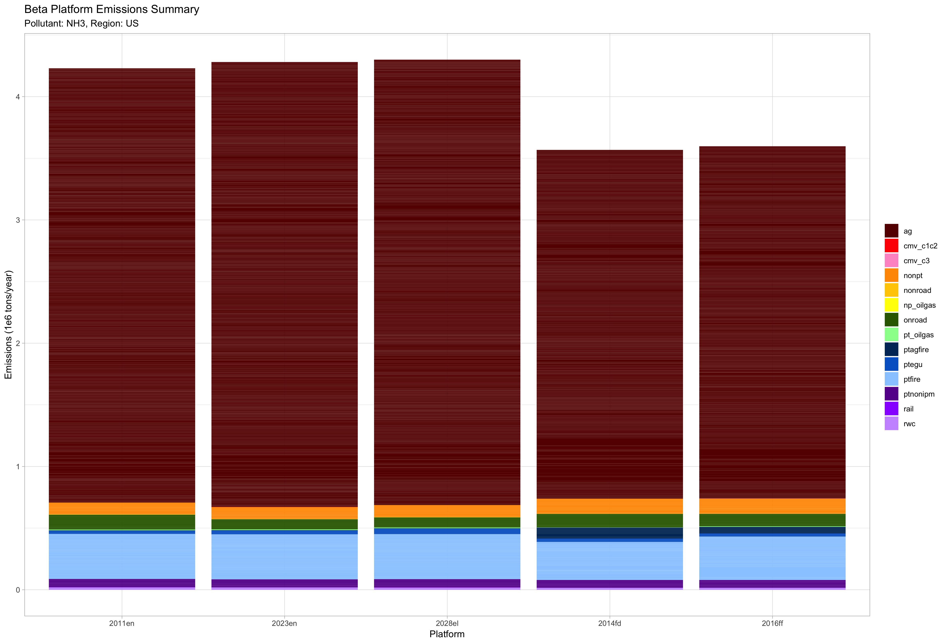
National NH₃ Emissions by Sector
2011v6 2023₂₀₁₁ 2028₂₀₁₁ 2014 2016beta
Notes:
Overall 2016 NH3 emissions are lower than 2011 (-15%) and slightly higher (0.8%) than 2014. These changes are primarily driven by the ag sector which are 18.9% lower in 2016 than 2011 and 1% higher than 2014.

Slide 27
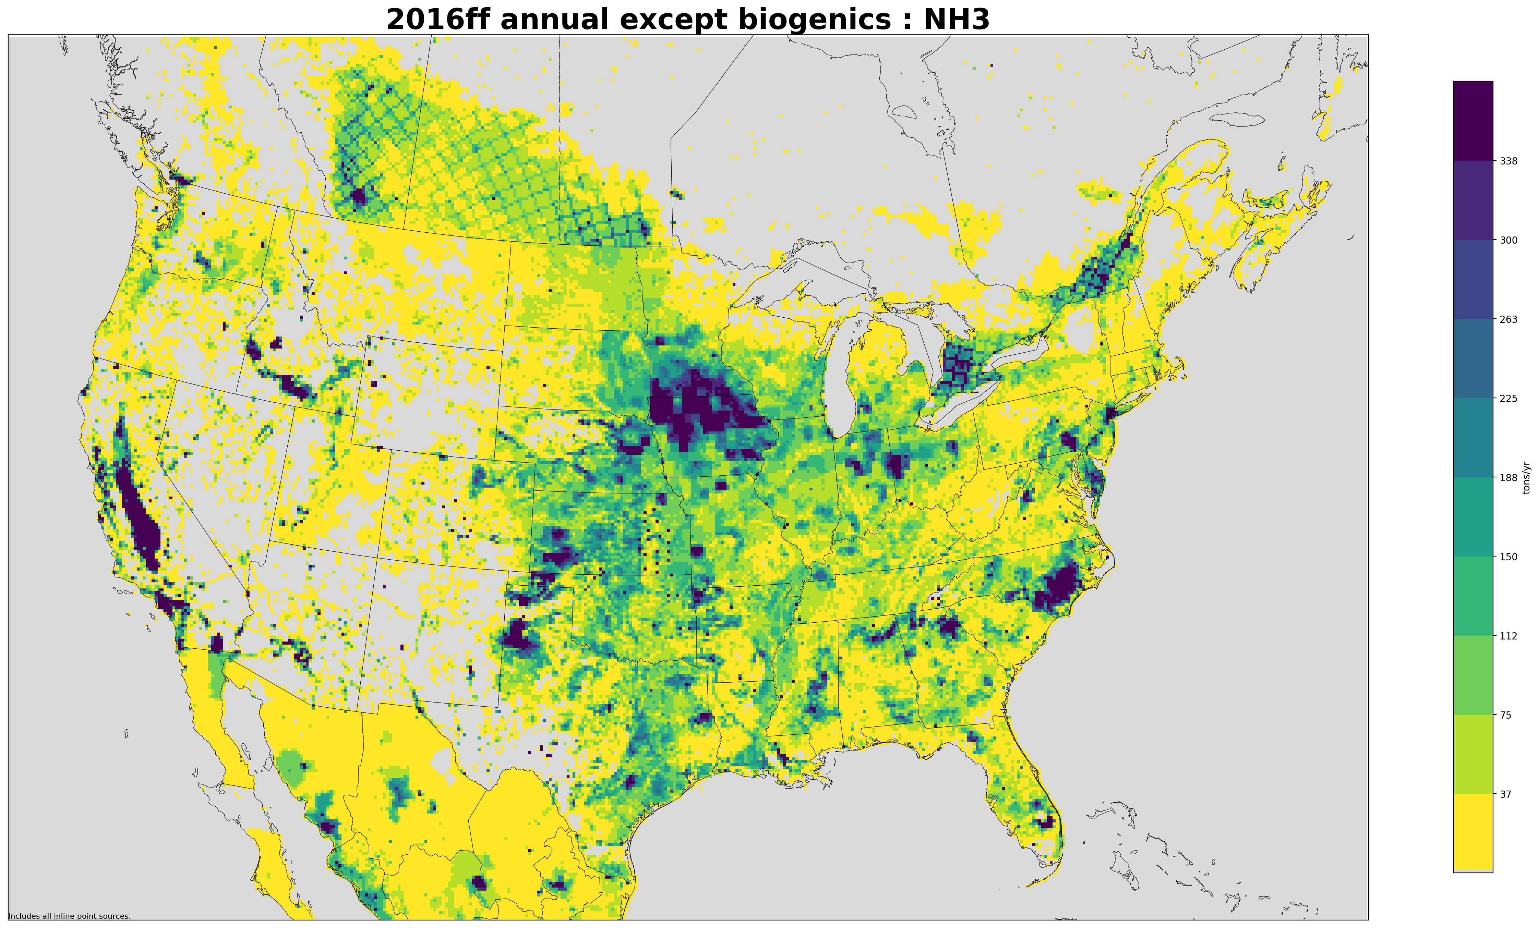
2016 Annual 12-km Gridded NH₃ Emissions (tons/year)
Notes:
Agricultural regions are highlighted: CA central valley, cornbelt, livestock in the TX and OK panhandle, IA and eastern NC; can also see fires as points; waffle pattern in Canada is a modeling artifact from the Canadian inventory being provided as a 10-km grid on a different projection that the EPA CONUS domain. EPA developed a solution and will correct this in the v1 platform

Slide 28
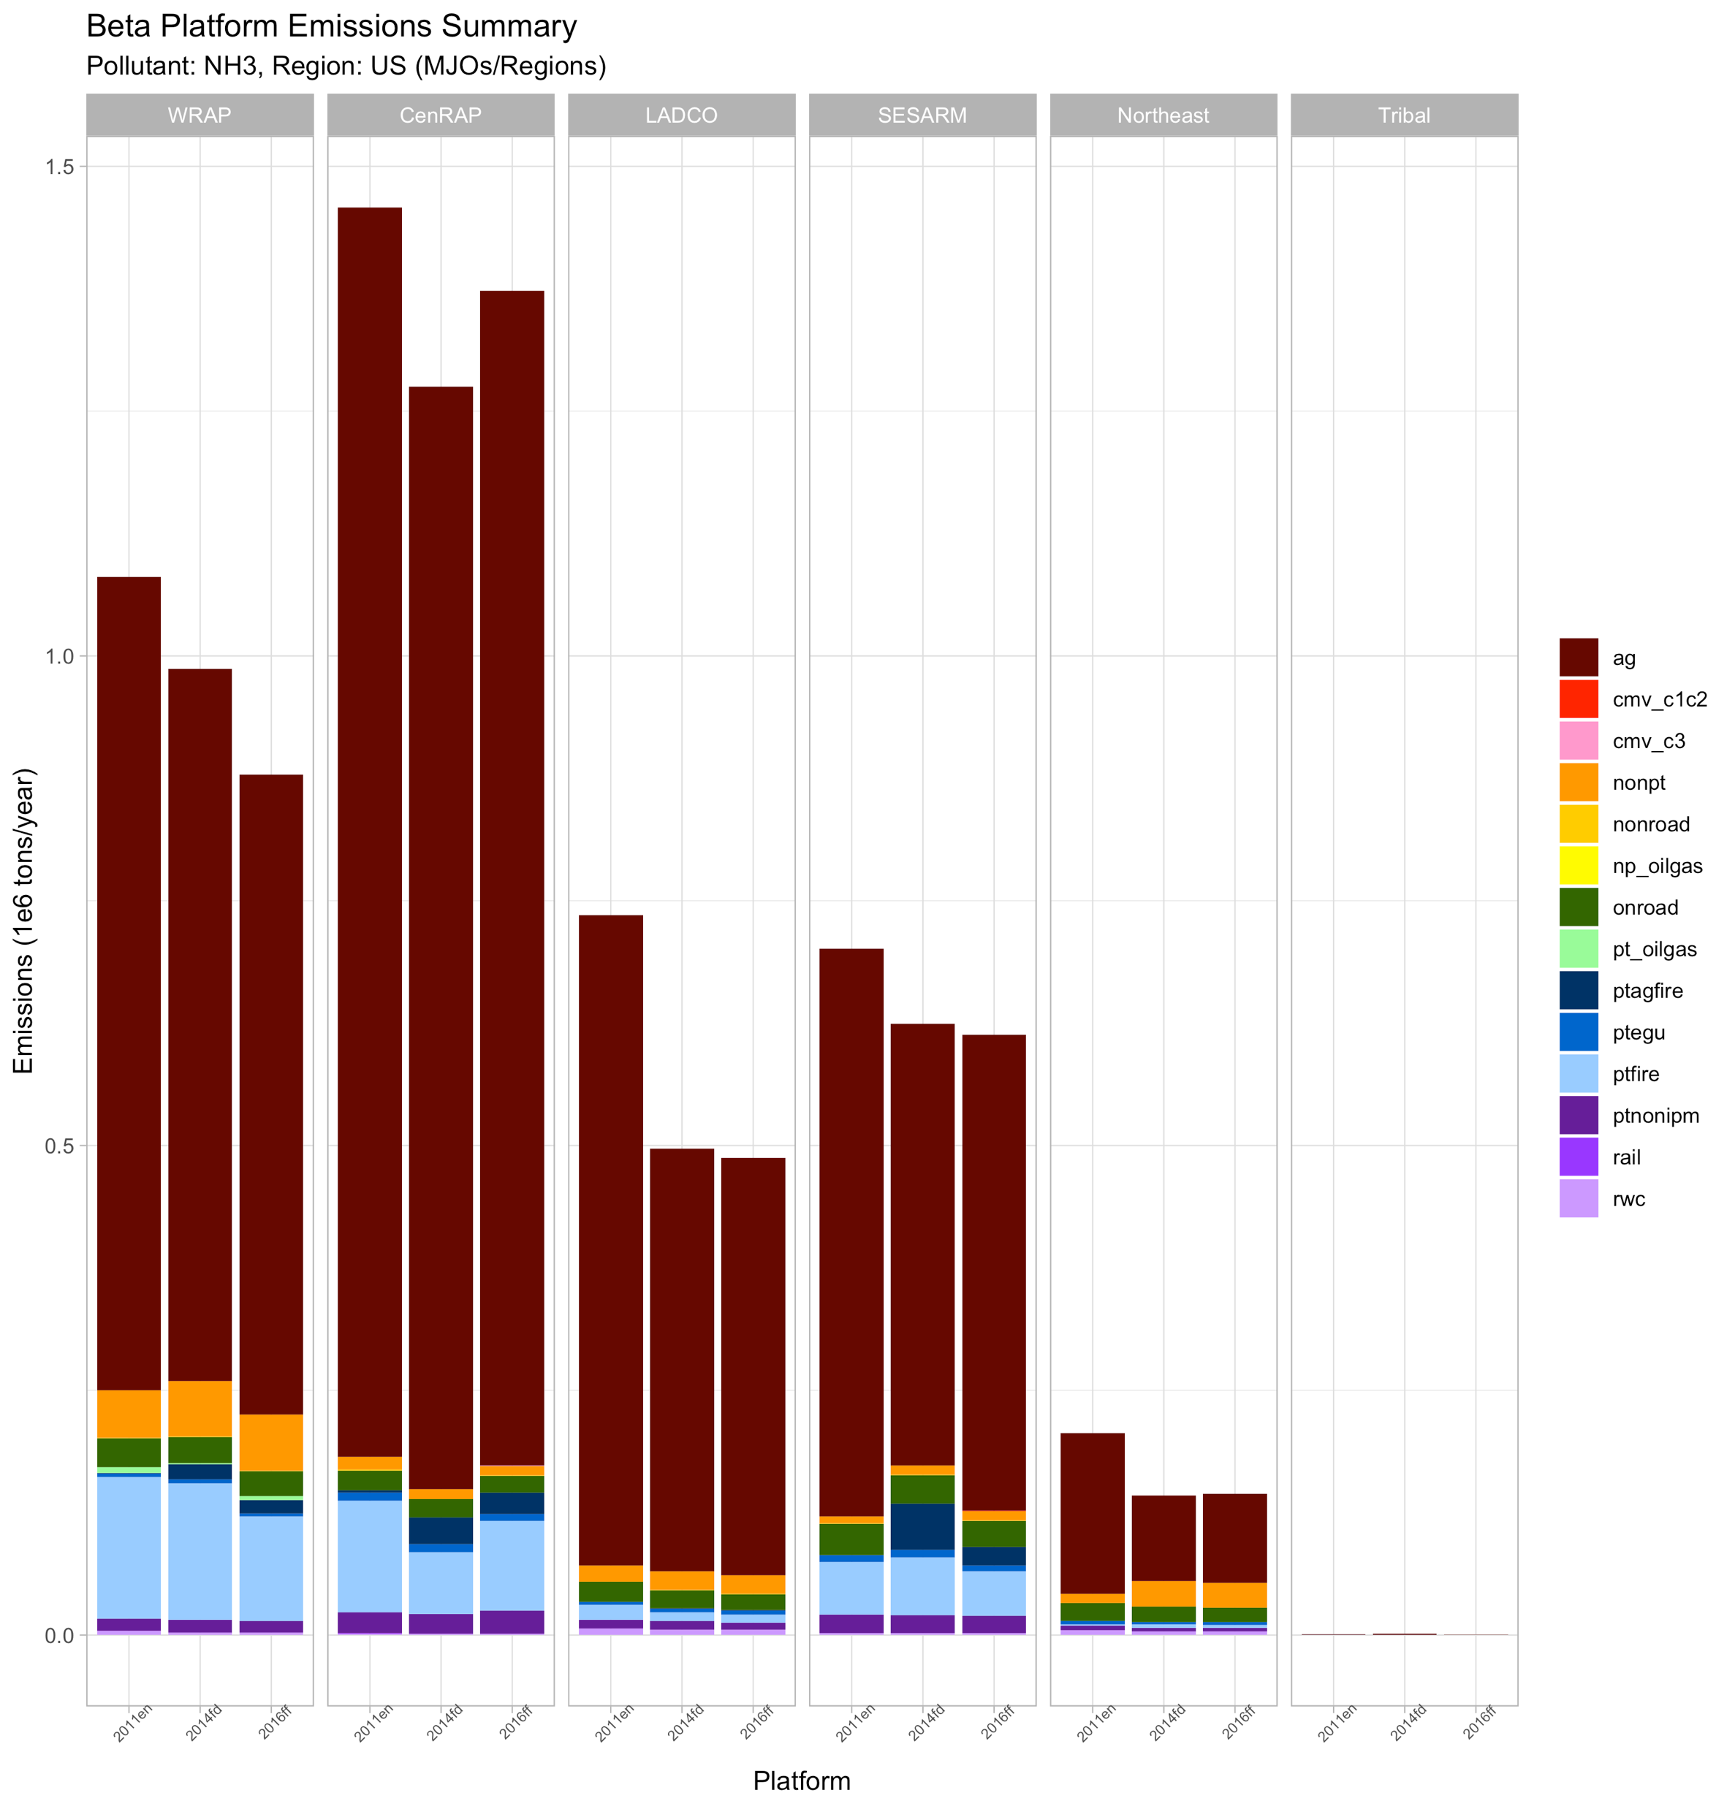
Regional NH₃ Emissions by Sector
CenRAP is the dominant region for ag NH3; although largest changes from 2011 to 2016 in the WRAP and LADCO regions

Slide 29
2016 beta Release Next Steps
2016beta emissions platform can be downloaded by component
  Inventories, ancillary data, software/scripts, MOVES EF tables, BELD landuse tiles
2016beta projections to 2023 and 2028 will be released to workgroups in April 2019
  Projection data for some sectors has already been provided
Collecting comments through May 31, 2019
  See instructions on the Wiki page

Slide 30
Collaborative Workgroup Reports
EGUs
Non-EGU Point
Nonpoint
Oil and gas sources (point and nonpoint)
Onroad
Nonroad
Rail
Commercial Marine Vessels (CMV)
Fires
Biogenics
Modeling
Wrap up
Wiki has more information and notes from each workgroup
  http://views.cira.colostate.edu/wiki/wiki/9169

Slide 31
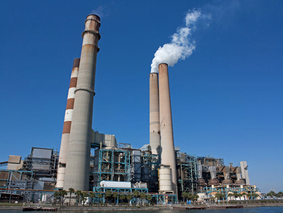
Electricity Generating Units (EGU) Workgroup
Co-leads: Julie McDill (MARAMA), Serpil Kayin (EPA CAMD), Alison Eyth (EPA OAQPS)
Schedule: Calls 4th Thursday at 2:00pm ET
Wiki: http://views.cira.colostate.edu/wiki/wiki/9174

Slide 32
EGU Workgroup: 2016 beta
Base year 2016 is complete
  Finalized crosswalks to prepare the inventory for platform compatibility with either ERTAC EGU or IPM projections
Temporal allocation for sources without CEMS data supports both peaking and non-peaking sources depending on the type of source
  Working on temporal allocation for future years that is compatible with base year methods
Working on supporting additional sources passed through into modeling files by the new IPM (e.g., MWCs)
See workgroup notes on the EGU Wiki page for more information

Slide 33
EGU Workgroup: ERTAC-EGU
Runs with new inputs from CONUSv16.0 are complete
  Current version: 16.0/beta
  Minor updates expected for 2016v1
    SE growth factor revisions
    Documentation updates
  16.0/beta modeling years
    Base year: 2016
    Projections: 2020, 2023, 2028
    Other years could be made available, if needed
  Runs are CSAPR-compliant, meet state assurance levels
Next Steps
  Focus on training through summer
  Expect to develop v16.1 by Fall 2019
    State outreach
    Updated growth factors (all)
    Updated shutdowns and controls

Slide 34
EGU Workgroup: ERTAC-EGU
Feedback from States
  Split = ERTAC EGU, “small EGU”, point non-IPM
    Eliminate double counting
    Confirm that “small EGU” sources are not already included in non-point
Temporalization
  Concerns about treatment of peaking sources by IPM
    IPM approach attenuates peaking unit emissions
  Seeking feedback from states about assignments of units as peaking units: applies to both IPM and ERTAC EGU models

Slide 35
EGU Workgroup: IPM
EPA has updated its Power Sector Modeling Website with the latest IPM projections (IPM v6 November 2018 Reference Case) including NEEDS, full-fledged documentation and unit level results for 2023 and 2030.
  Please visit https://www.epa.gov/airmarkets/clean-air-markets-power-sector-modeling
EPA will be giving an IPM v6 November 2018 Reference Case Webinar on 04/04/2019 between 2:00 PM – 3:00 PM
  Join webinar: https://epawebconferencing.acms.com/ipmv6webinar/
  Conference Number: 1 (202) 991-0477 Participant Code: 311200
EPA gave a presentation at the EGU WG call on 2/28 showing IPM v6 results with ERTAC projections (see wiki for Results Viewer and comparison spreadsheet)

Slide 36
IPM EGU: Ozone Season NOx Emissions
IPM projections assume EGUs operate at the same Ozone Season NOx emission rate as observed in 2018 for CSAPR Update compliance (for those reporting data)
Any announced control installations are factored into 2023 projections
The decrease in projected emissions are largely driven by announced retirements and rate improvements

Slide 37
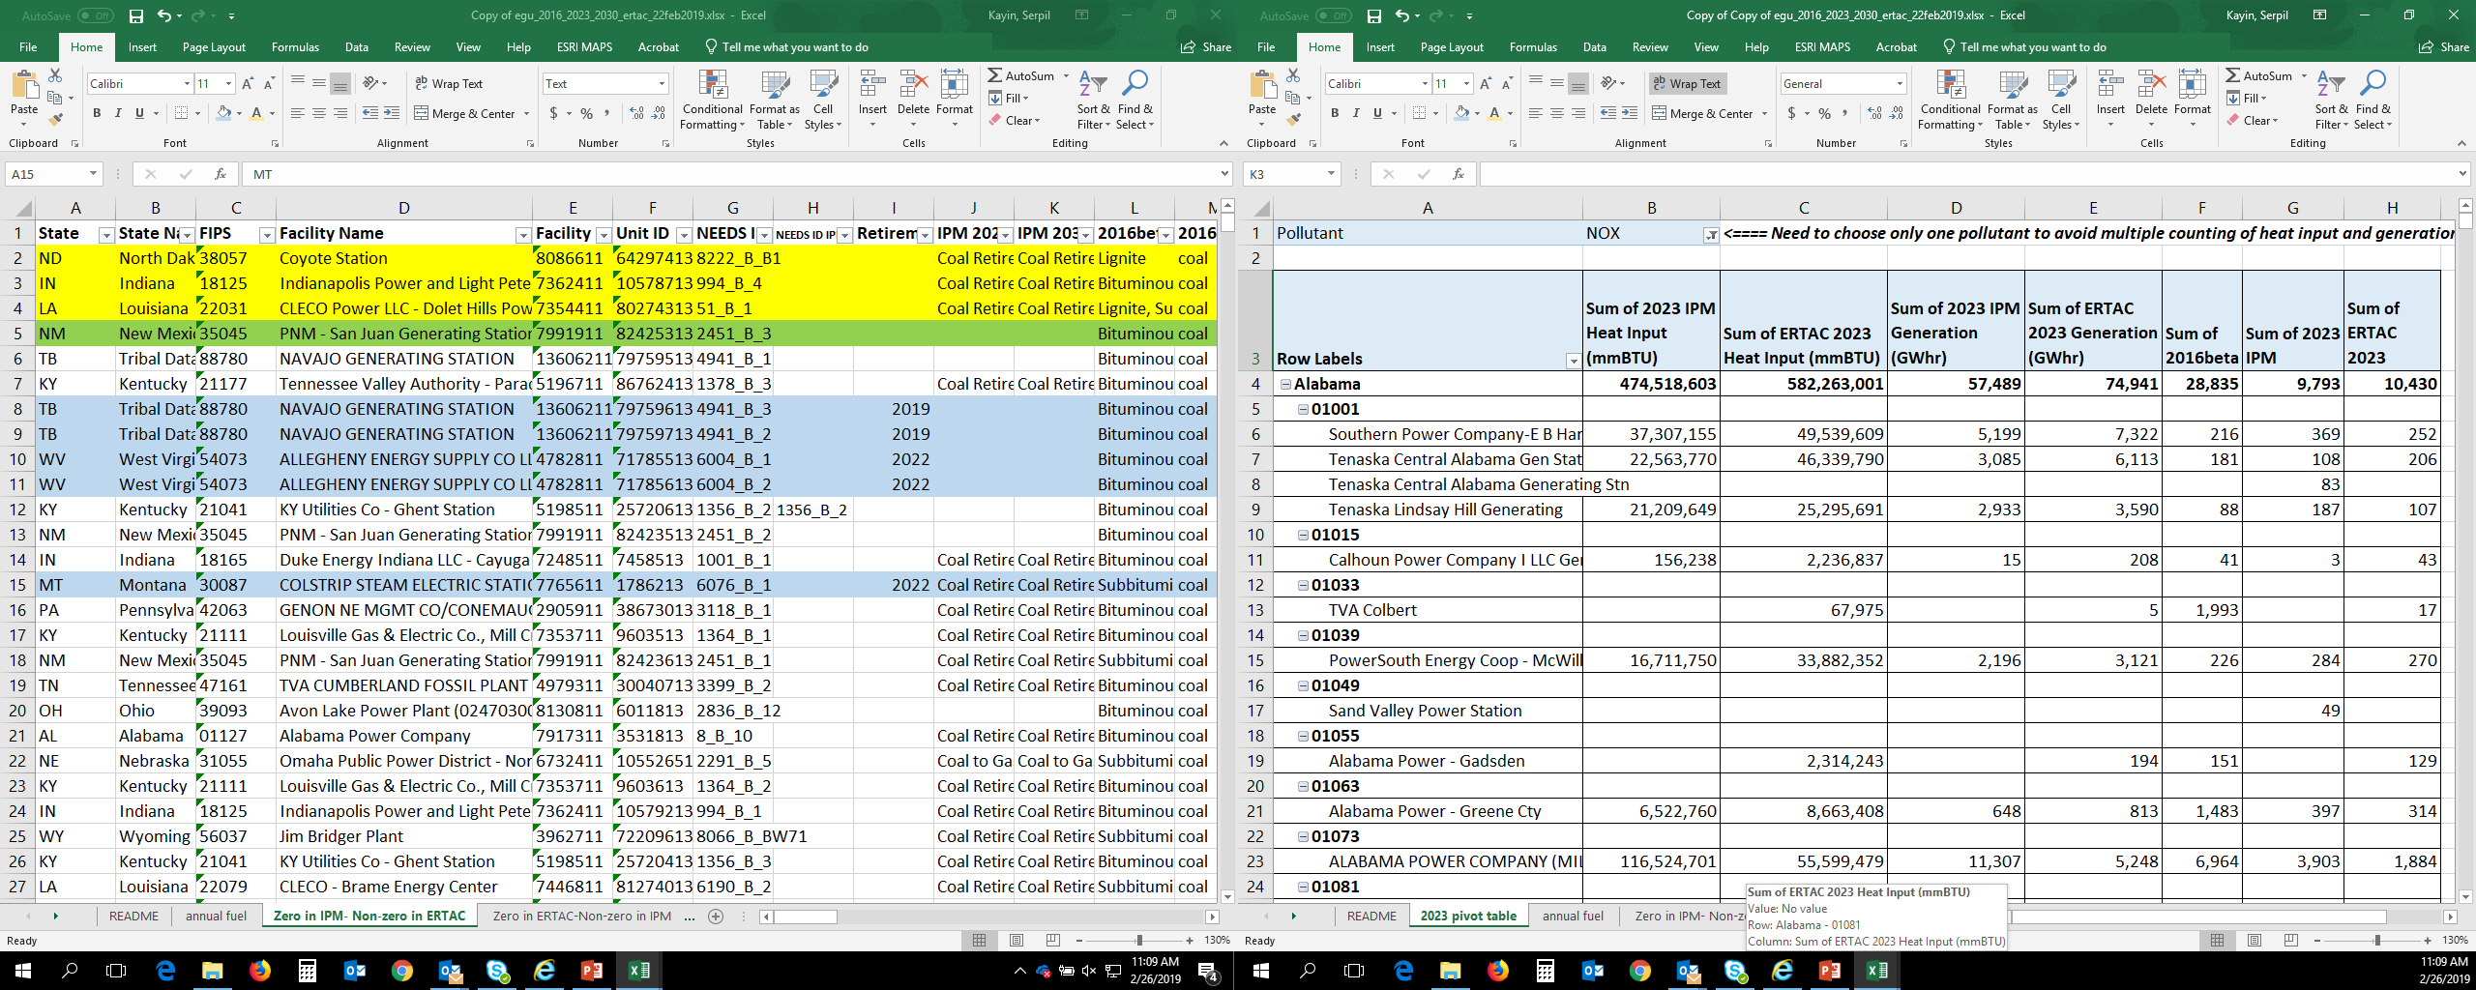
Comparing 2016 Beta Inventory with IPM and ERTAC Projections
“annual fuel”: all units from IPM and ERTAC, matched as best as possible; includes all pollutants. The README file explains all of the columns.
“Zero in IPM- Non-zero in ERTAC”: all of the NOx units where ERTAC has non-zero emissions in 2028, but IPM has zero emissions in 2030 (and the emissions are non-zero in 2016).
“Zero in ERTAC- Non-zero in IPM”: all of the NOx units where IPM has non-zero emissions in 2028, but ERTAC has zero emissions in 2028 (and the emissions are non-zero in 2016).

Slide 38
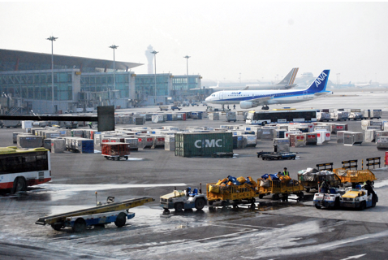
Non-EGU Point Workgroup
Co-leads: Tammy Manning (NC DEQ), Caroline Farkas (EPA)
Schedule: Calls on 3rd Tuesday at 2:00pm Eastern
Wiki: http://views.cira.colostate.edu/wiki/wiki/9177

Slide 39
Non-EGU Point Workgroup: 2016beta
Summary
  Base year (2016)
    Includes reported emissions from 2016 and 2014
    ~22,000 non-airport facilities reported for 2016; remainder pulled forward from 2014
  Projection years (2023 & 2028)
    Industrial sources projected by SCC and SCC-NAICS using AEO 2018 tables
    Control factors reevaluated (e.g., Boiler MACT (for NC), RICE NSPS, Process Heaters NSPS, Natural Gas NSPS, Petroleum refineries (Subpart JA), CISWI)
  Workgroup members are reviewing 2016 base year and providing comments by April 16
  Workgroup will review Projection years in April/May

Slide 40
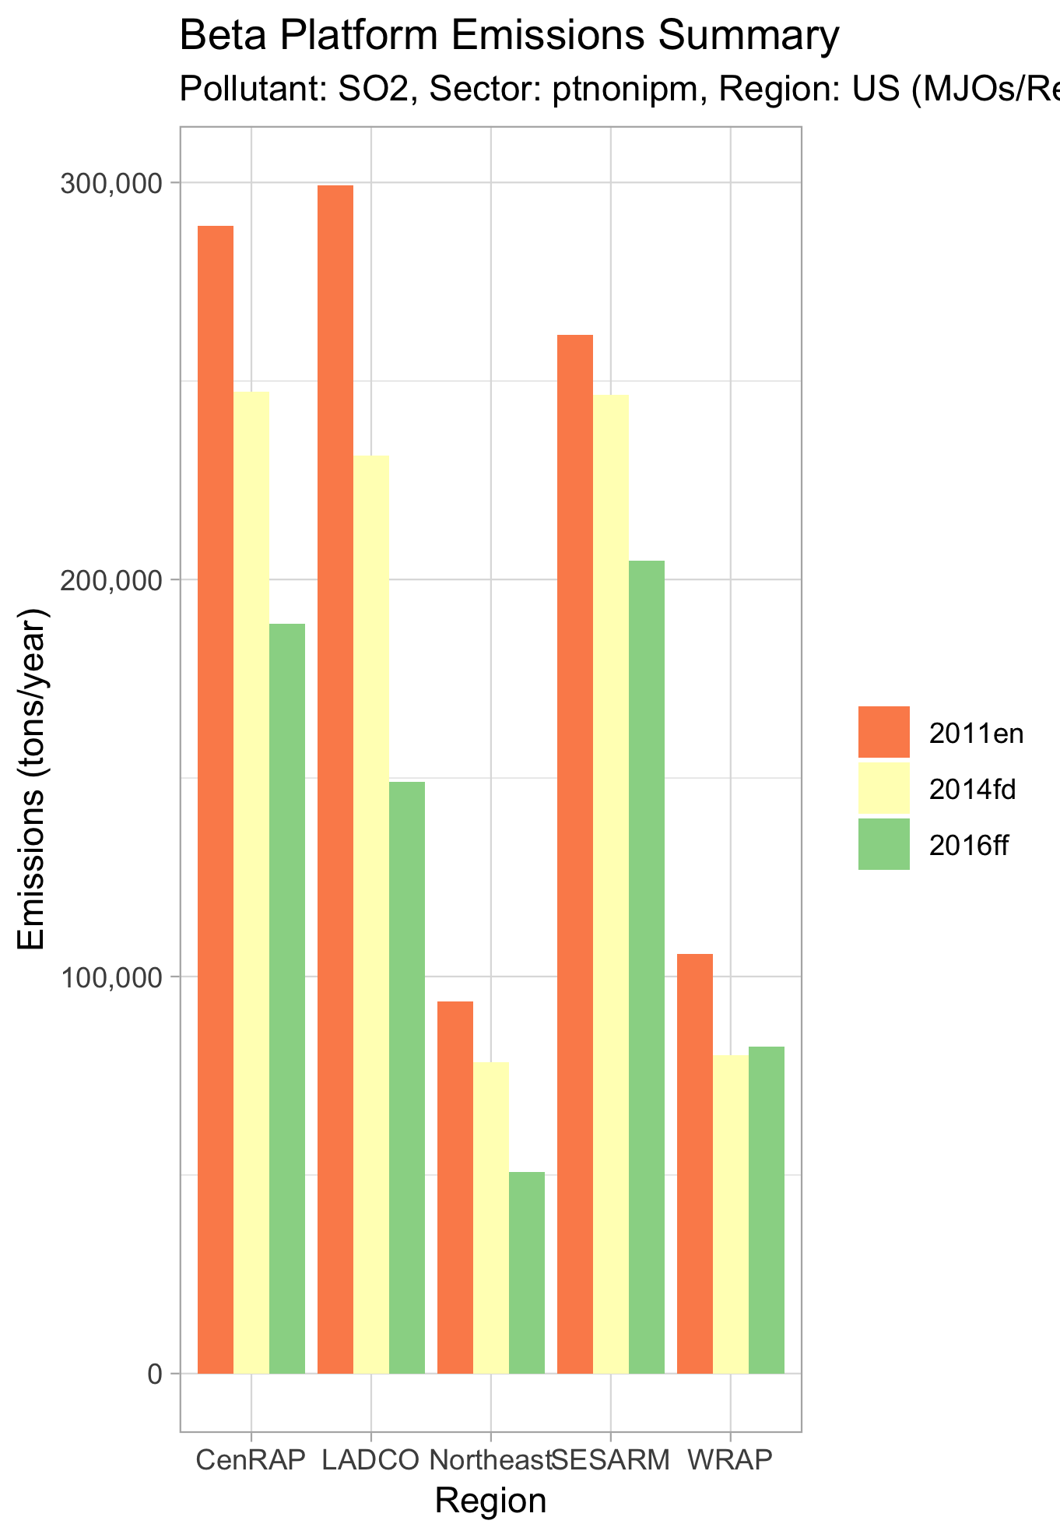
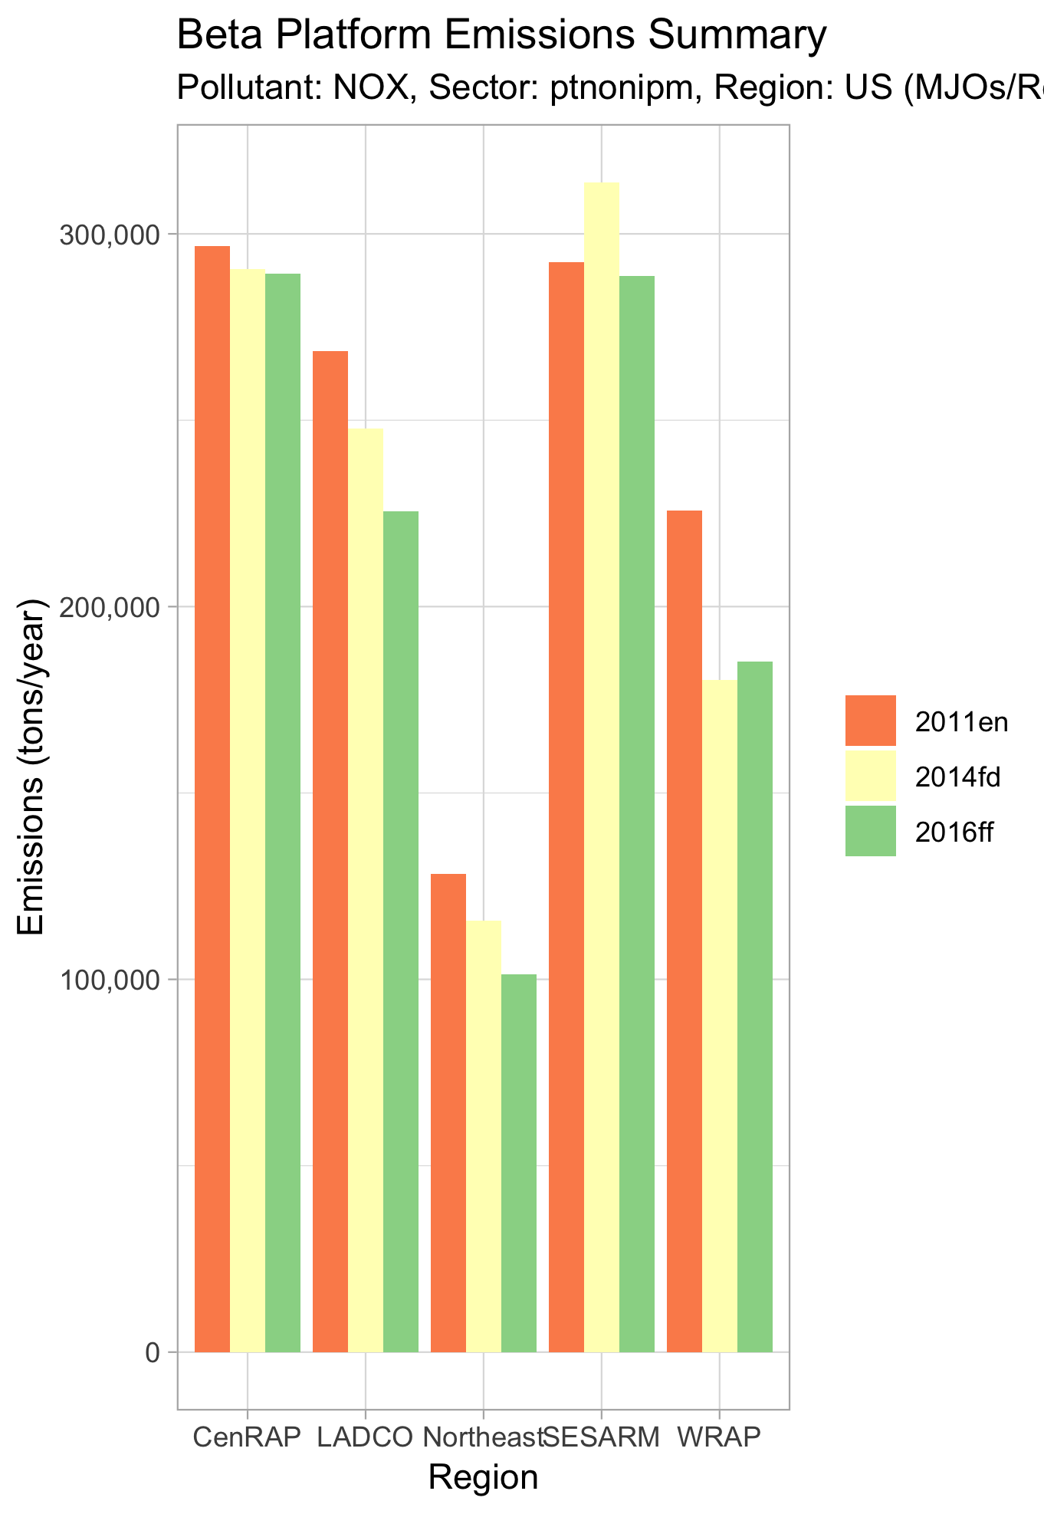
Non-EGU Point 2016beta: NOx & SO2

Slide 41
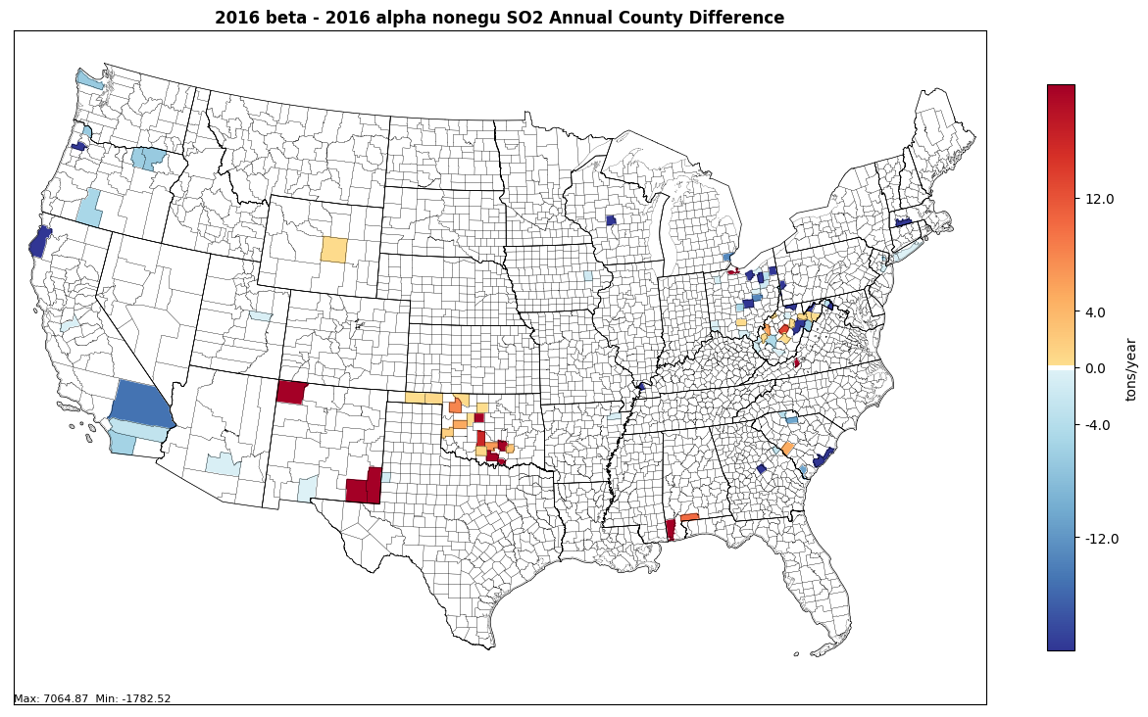
Non-EGU Point SO2: 2016beta – 2016alpha

Slide 42
Non-EGU Point Workgroup: 2016v1
Approach
  Majority of approach will be the same as beta
  Aircraft emissions will be created from new FAA model (AEDT)
Differences from beta
  Base Year (2016):
    aircraft emissions updated with new model results
    edits from State comments
  Projection Years (2023 & 2028):
    will include projections using new aircraft base year
    some additions/edits to control and growth packets
    States will be submitting some of their own growth factors
Milestones
  Expected review date: June 2019
  Expected release date: Summer 2019

Slide 43
Nonpoint Workgroup
Co-leads: Caroline Farkas (EPA), Jennifer Snyder (EPA)
Schedule: Calls on 4th Monday at 2:00pm Eastern
Wiki: http://views.cira.colostate.edu/wiki/wiki/9178

Slide 44
Nonpoint Workgroup: 2016beta
Summary
  Base year (2016)
    Ag livestock projected to 2016 using USDA county-level survey data
    RWC projected to 2016 using MARAMA’s projection tool
    Population-based activity data updated to 2016
  Projection years (2023 & 2028)
    Industrial sources projected by SCC and SCC-NAICS using AEO 2018 tables
    Ag livestock projected using USDA national projections
    Population-based activity data grown using Woods & Poole population projections
    Control factors reevaluated including RICE NSPS
  Workgroup members are reviewing 2016 base year and providing comments by April 22
  Workgroup will review Projection years in April/May

Slide 45
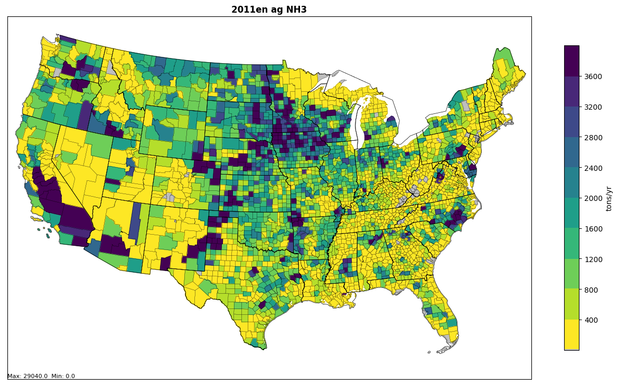
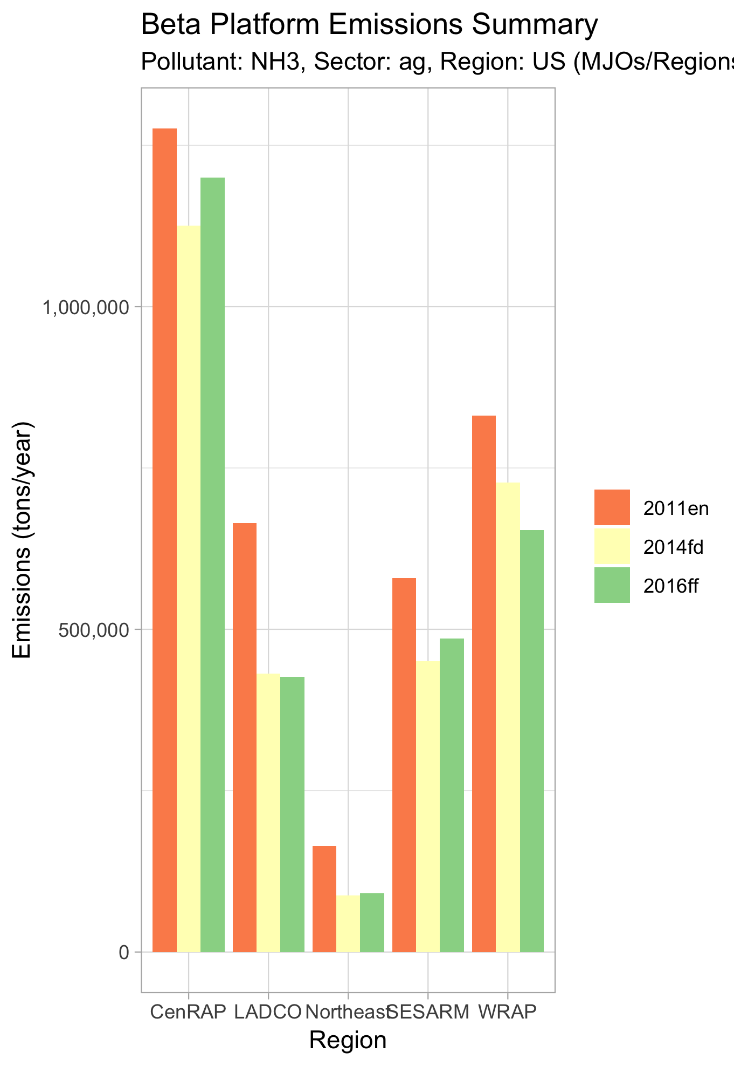
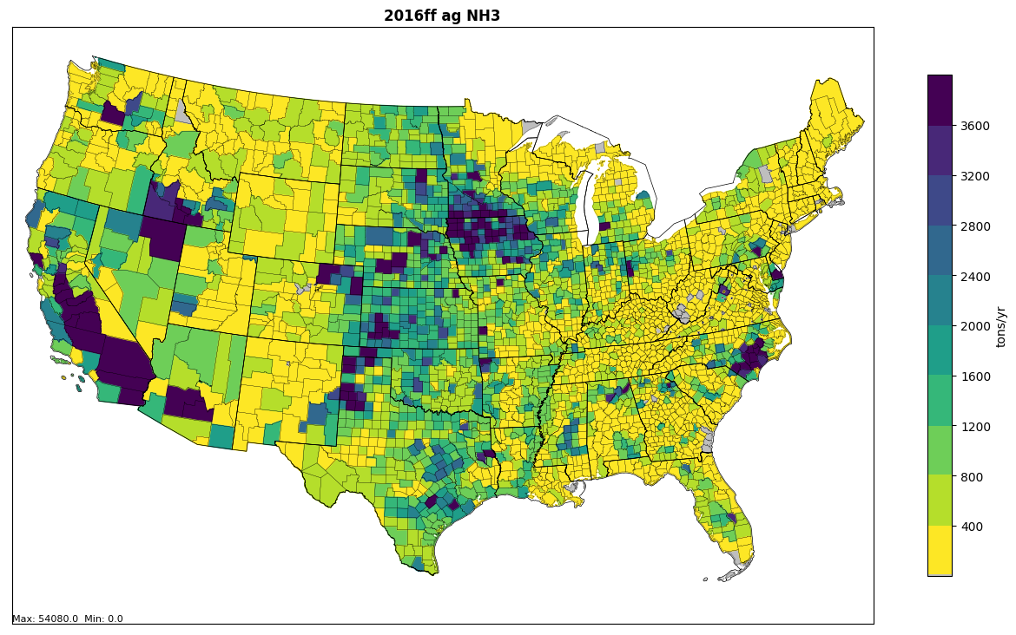
Nonpoint Ag
2011 vs 2016beta

Slide 46
Nonpoint Workgroup: 2016v1
Approach
  Majority of approach will be the same as beta
Differences from beta
  Base Year (2016)
    Ag livestock update/correction (dairy cows underestimated in 2014NEIv2)
    SEDs data for at least some states to project 2014 emissions to 2016
  Projection Years (2023 & 2028)
    additions/edits to control and growth packets
    Some states will be submitting their own growth factors
Milestones
  Expected review date: June 2019
  Expected release date: Summer 2019

Slide 47

Oil and Gas Workgroup
Co-leads: Tom Richardson(OKDEQ), Jeff Vukovich (EPA)
Schedule: Calls on 2nd Monday at 2pm Eastern
Wiki: http://views.cira.colostate.edu/wiki/wiki/9180

Slide 48
Oil and Gas: 2016beta summary
Base year
  EPA Oil and Gas Tool used for base year non-point emissions
    State-submitted data/technical direction from CA, CO, OK, and PA
  Oil and Gas point source inventory consists of year 2016 and 2014 emissions
    Year 2014 sources projected to year 2016
  New gridding surrogates and monthly profiles used
Future year projections (2023 and 2028)
  Growth
    Non-point exploration SCCs: 2014 and 2016 averaged activity used to estimate emissions
    Point source and non-point production SCCs: AEO 2018 Reference case forecasts and historical state information
  Controls (e.g. NSPS)
    Non-point: RICE NSPS and Oil and Gas NSPS
    Point: NSPS: RICE, Oil and Gas, Process Heaters and NG Turbines; MANE-VU Sulfur Rules, Boiler MACT (NC)

Slide 49
Oil and Gas: 2016beta national emissions summary

Slide 50
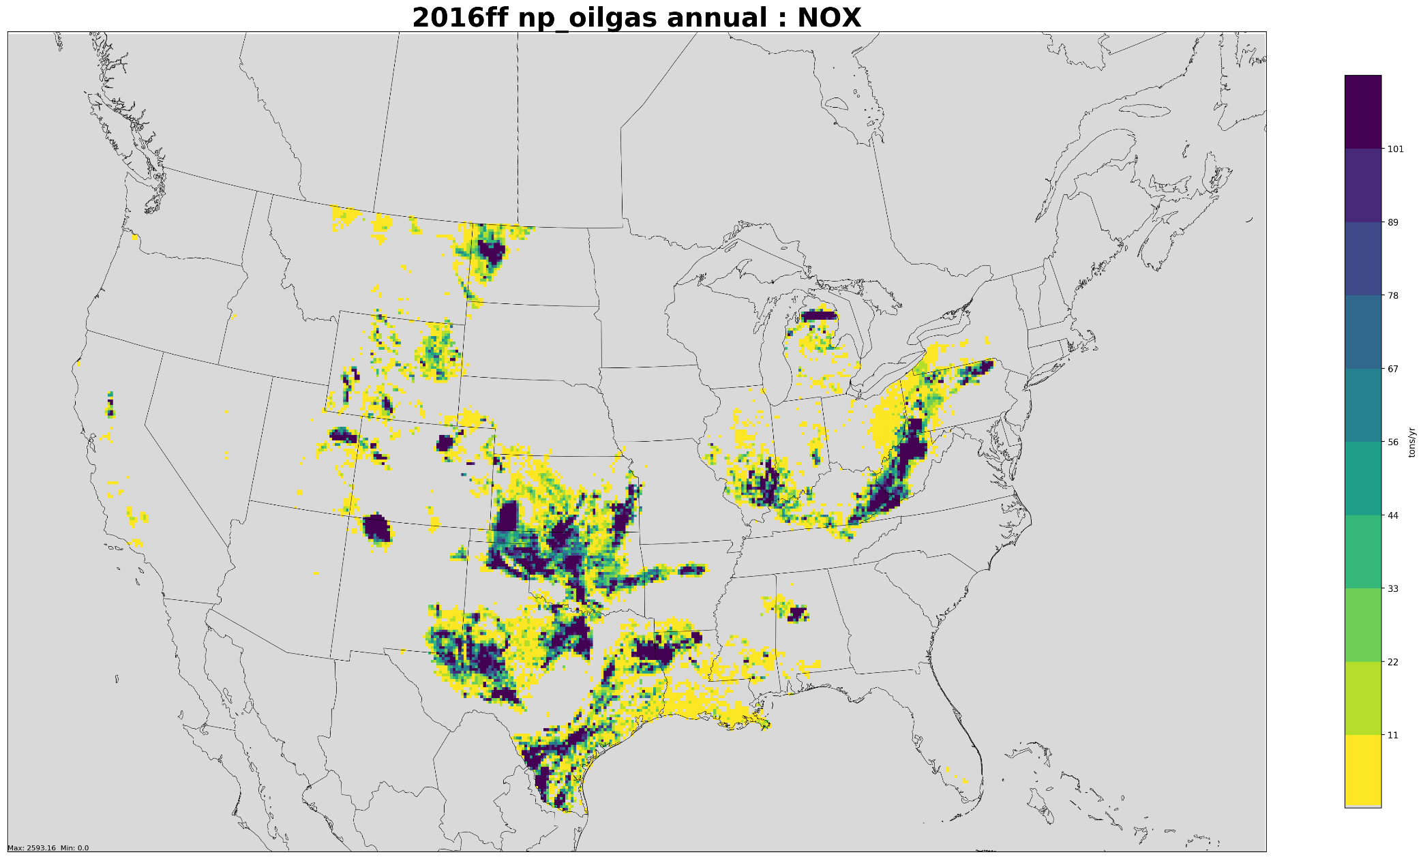
Oil and Gas non-point source
Annual Emissions (tons/yr): NOx
100

Slide 51
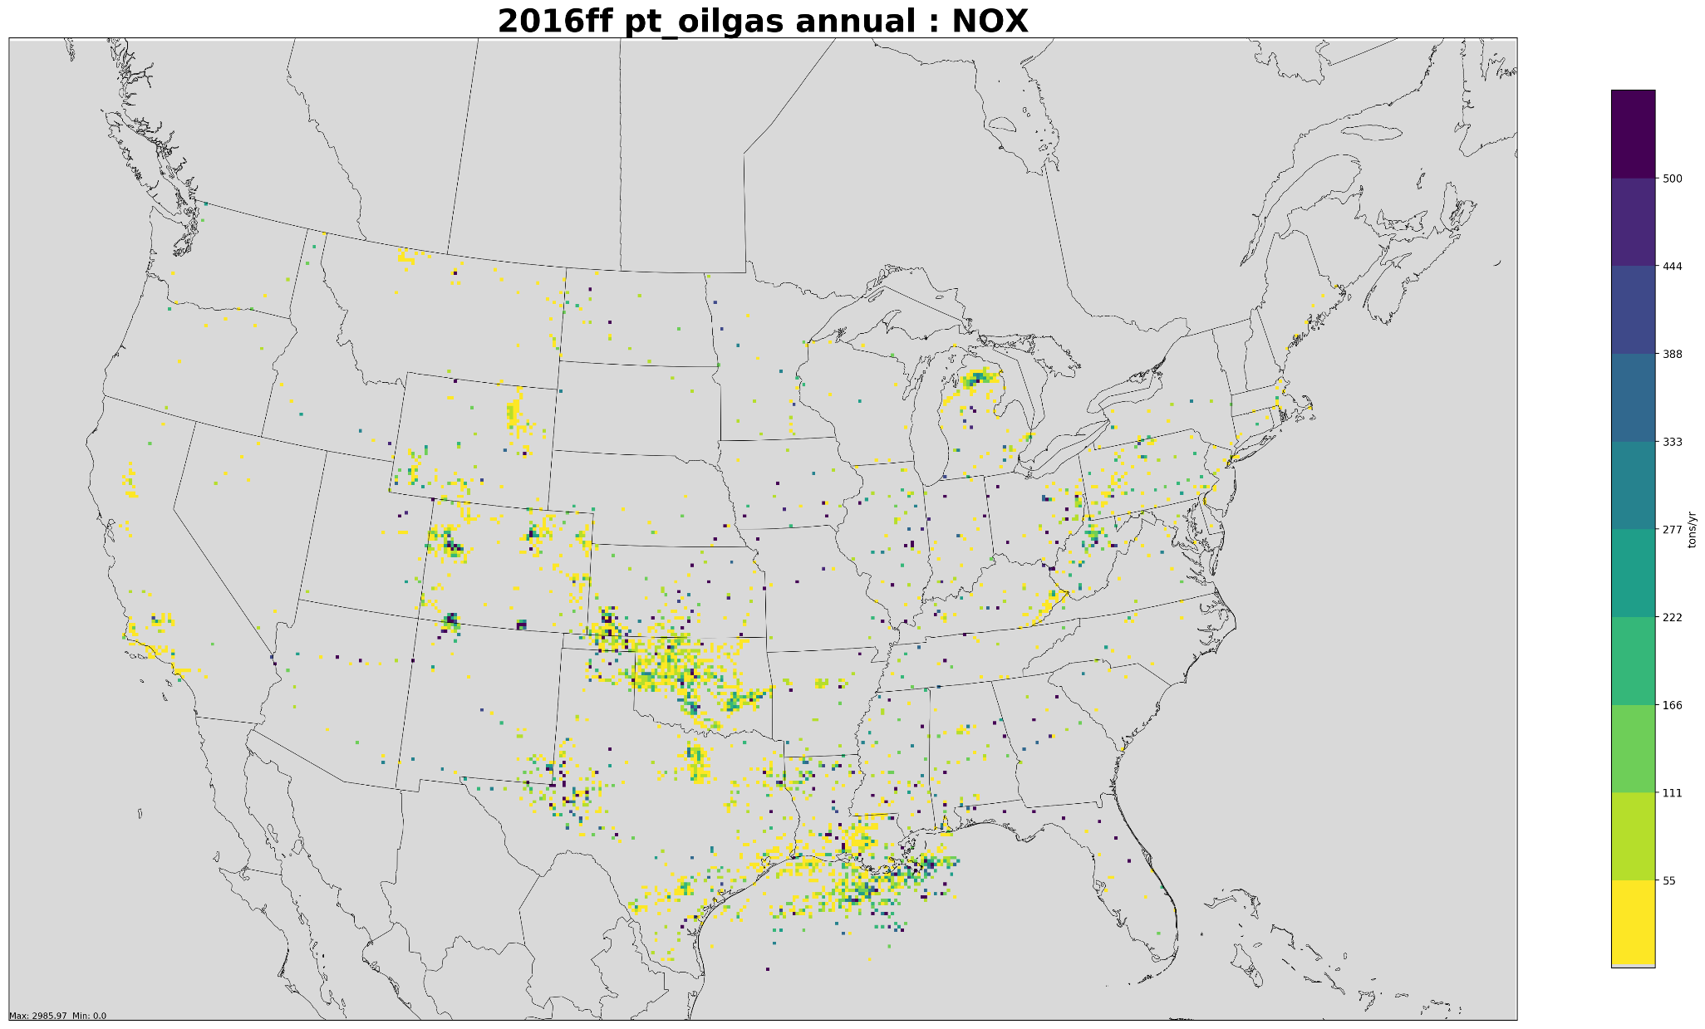
Oil and Gas point source
Annual Emissions (tons/yr): NOx
500

Slide 52
Oil and Gas Workgroup: 2016v1
Approach
  Respond to any comments that are due by May 31, 2019
  Base year updates
    Pennsylvania non-point
    No plans to update point
  Future year updates
    Another year of historical production data available (2018)
    AEO 2019 Reference case vs. other cases
    Grow transmission, distribution, storage point sources?
Differences from beta
  Base Year (2016): PA update
  Projection Years (2023 & 2028): AEO2019 and historical data updates plus state agency feedback; possibly higher resolution than region/state level
Milestones
  Expected review date: June 30, 2019
  Expected release date: Summer 2019

Slide 53
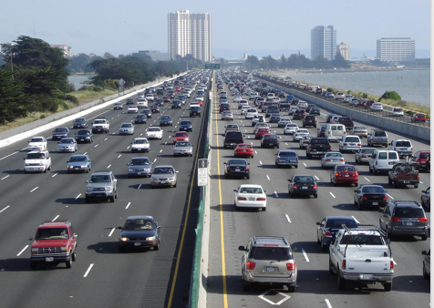
Onroad Mobile Workgroup
Co-leads: Julie McDill (MARAMA), Alison Eyth (EPA OAQPS)
Schedule: Calls 3rd Thursday at 2:00pm ET
Wiki: http://views.cira.colostate.edu/wiki/wiki/9181

Slide 54
Onroad Workgroup: Beta Summary
About a dozen state and local agencies submitted activity data for 2016, 2023, and 2028
  EPA allocated submitted activity to SCCs and projected activity for remaining areas
EPA ran SMOKE-MOVES to produce emissions for 2016, 2023, and 2028
  MOVES 2014NEIv2 input databases were reconfigured to 2016, 2023, and 2028 and used to create emission factors
  2016 meteorology and spatial surrogates

Slide 55
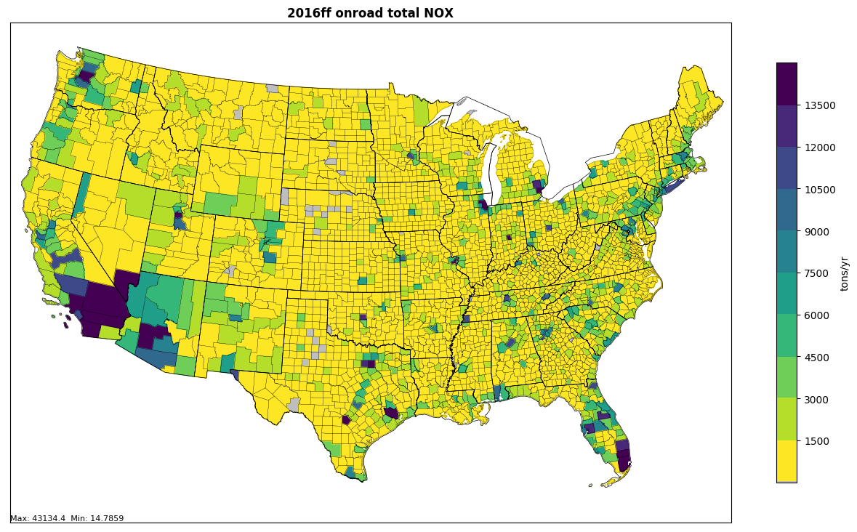
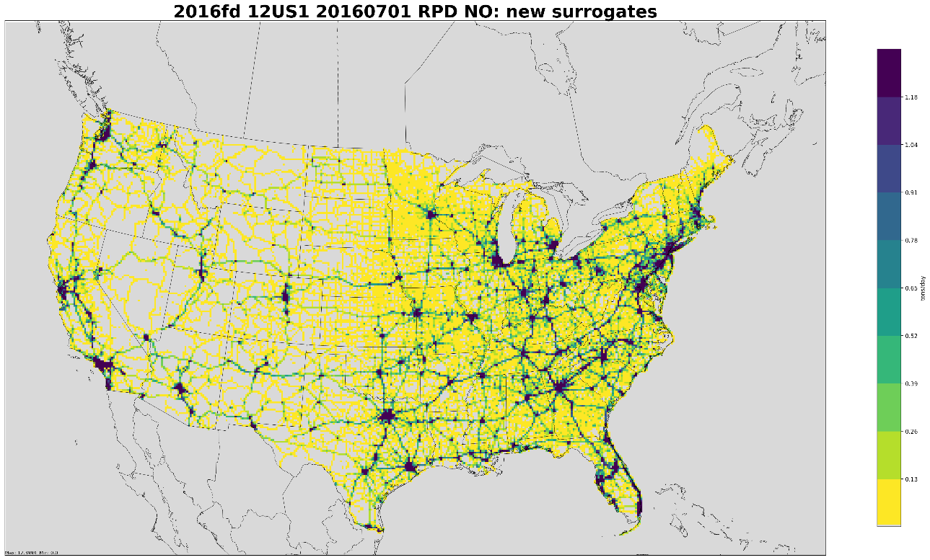
2016 beta Onroad Mobile
Annual NOx Emissions
Total Onroad NOx by county
NOx tends to be highest in urban areas and along interstates
12-km Gridded On-roadway NOx
The 12km gridded data used for modeling visibly resolves interstates and smaller highways

Slide 56
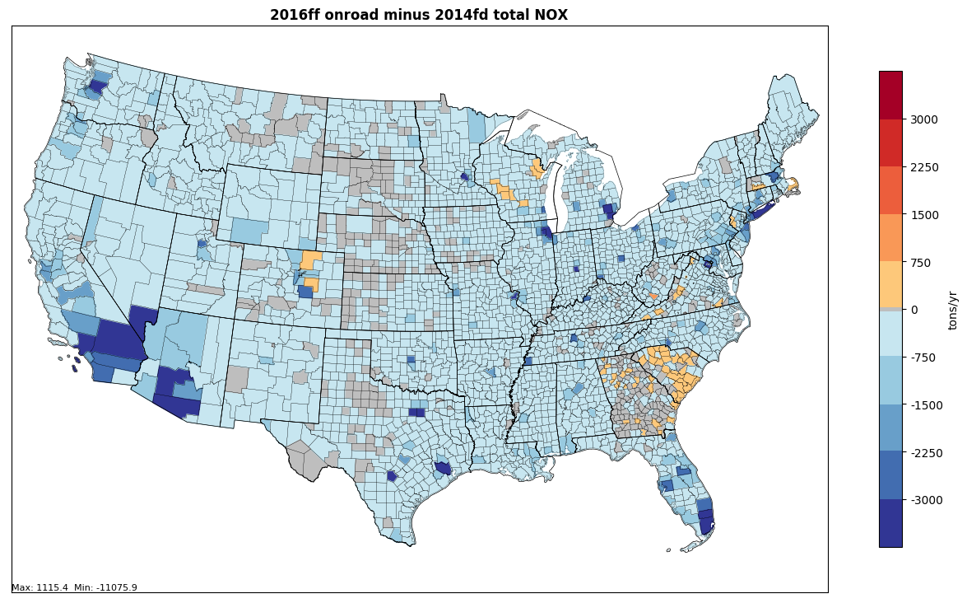
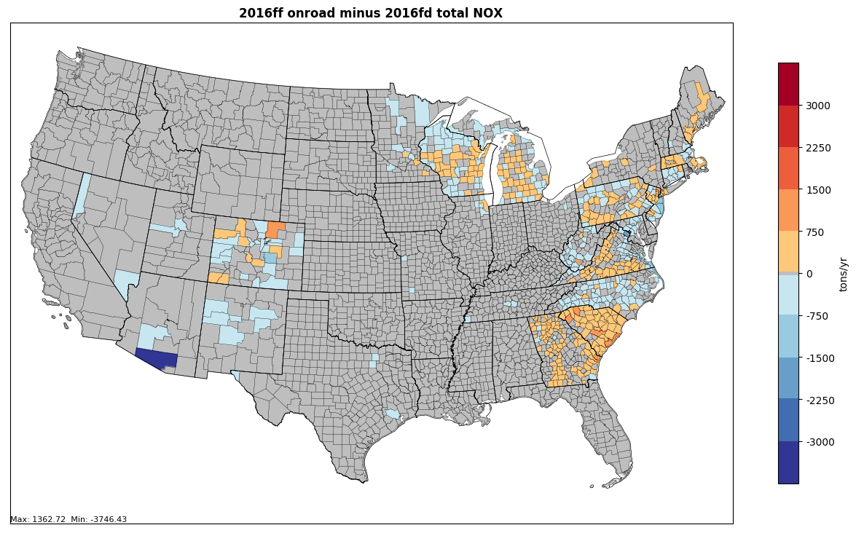
Onroad NOx Emissions Differences
2016 beta is lower than 2014NEIv2 in most areas except where there were substantial changes in activity data
Beta minus 2014 (tons)
Beta minus alpha (tons)
2016 beta is similar to 2016 alpha except where new activity data were used

Slide 57
2016 Beta U.S. Onroad Emissions

Slide 58
2016 Beta U.S. Onroad Emissions
Pollutant | 2016ff | 2023ff | 2028ff
CO | 20,330,093 | 14,251,351 | 10,427,337
NH3 | 100,841 | 87,246 | 83,631
NOX | 4,065,540 | 1,953,938 | 1,353,757
PM10-PRI | 272,770 | 224,706 | 211,037
PM25-PRI | 130,564 | 78,910 | 63,041
SO2 | 27,547 | 12,397 | 11,547
VOC | 1,985,763 | 1,195,488 | 885,883

Slide 59
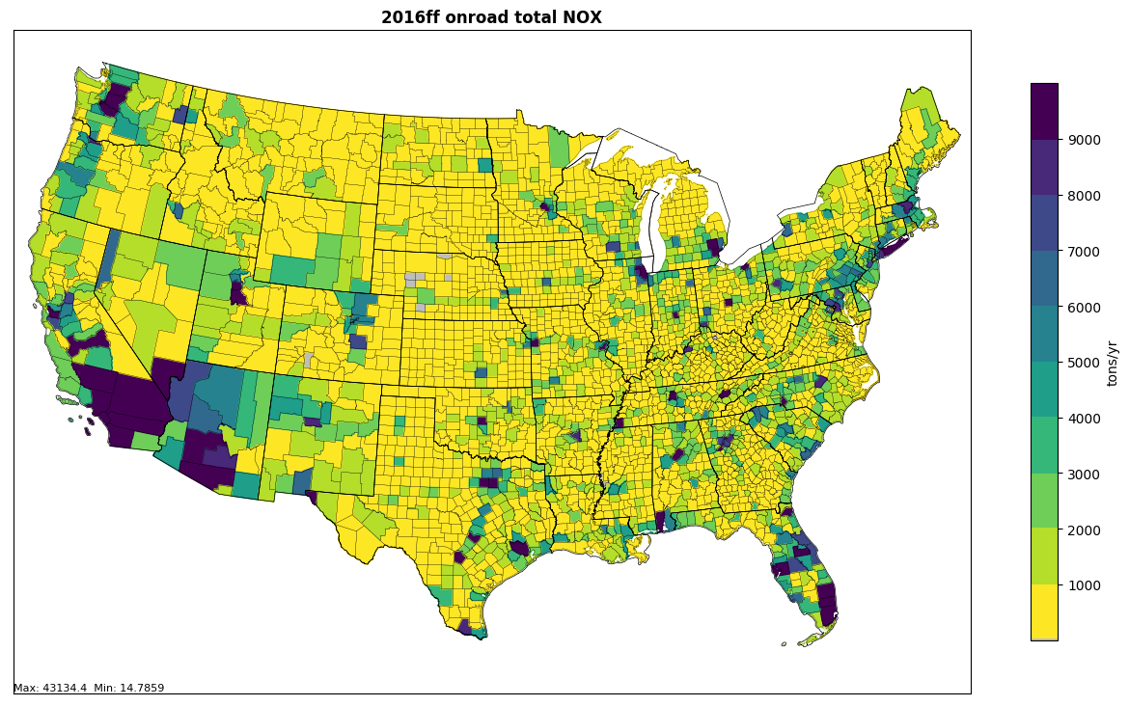
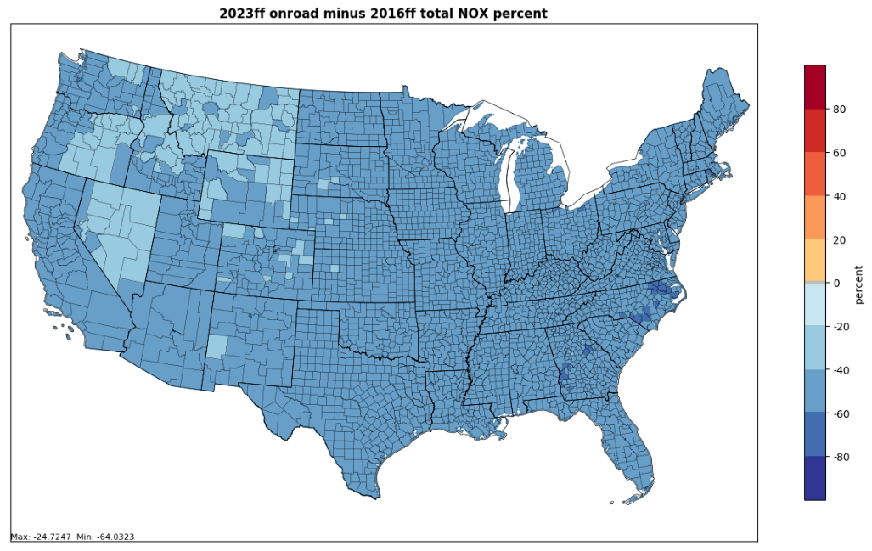
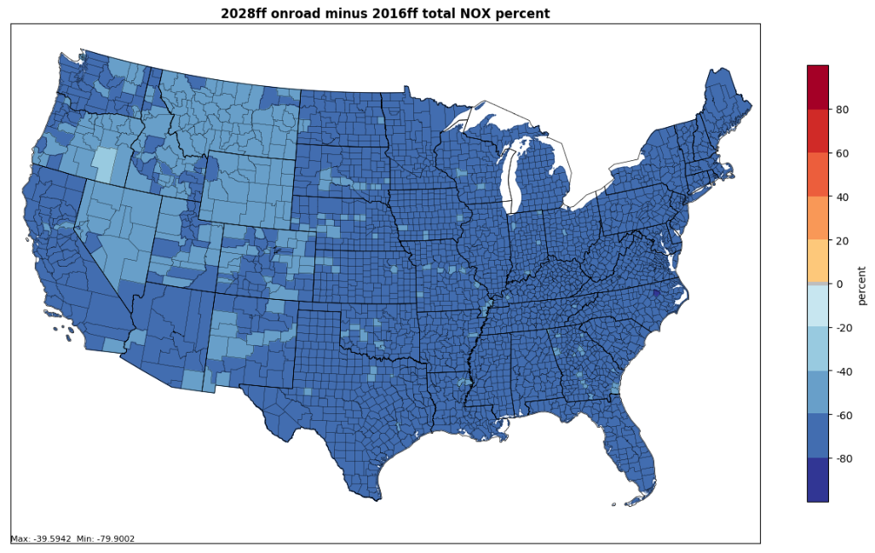
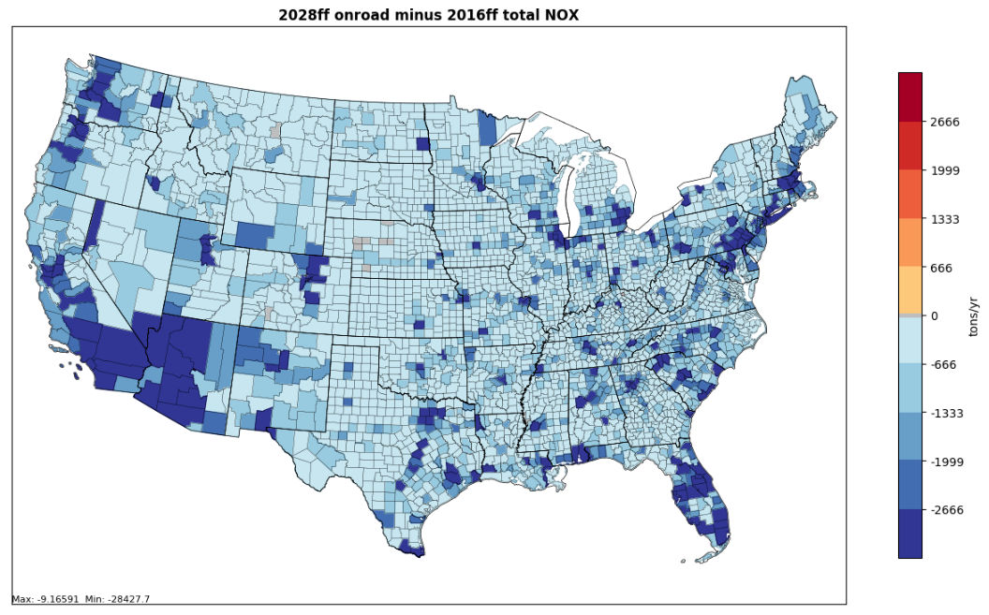
2016 Onroad NOx to 2023 and 2028
2016
2023-2016 (%)
2028-2016 (%)
2023-2016

Slide 60
Onroad Workgroup: Path to 2016v1
Approach
  New state-supplied input data will be incorporated
  Vehicle age distributions to be updated to represent 2016 based on CRC A-115 VIN decode project for 2017 NEI
  Representative counties will be reviewed
  MOVES will be run to create new emission factors
  SMOKE-MOVES will be run with the new emission factors with some activity updates to create emissions
Differences from beta
  Updated inputs will result in impacts at the state and county levels
2016v1 Milestones for base and future years
  Expected review date: June 2019
  Expected release date: Summer 2019

Slide 61
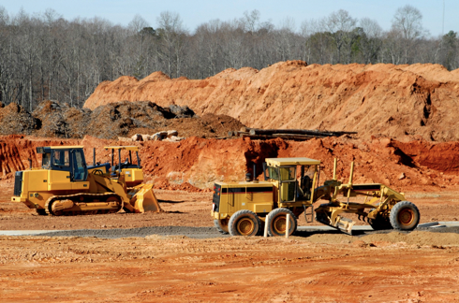
Nonroad Mobile Workgroup
Lead: Sarah Roberts (EPA OTAQ)
Schedule: Calls on 4th Thursday at 3:30pm Eastern
Wiki: http://views.cira.colostate.edu/wiki/wiki/9179

Slide 62
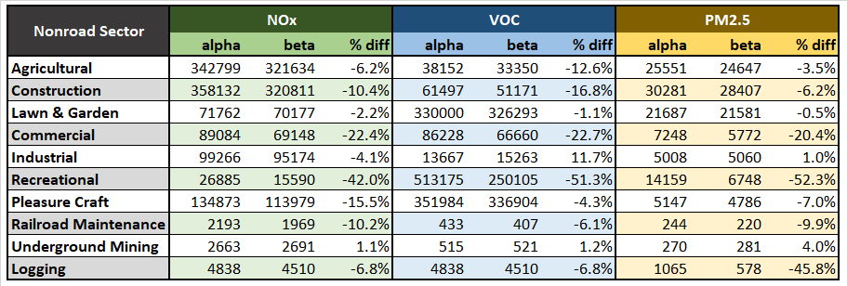
Nonroad Workgroup: 2016 beta summary
For beta, ran MOVES2014b using model defaults (no state-supplied data)
For most equipment sectors, national nonroad beta inventory lower than alpha inventory (results vary by pollutant and location)
Differences between alpha and beta inventories primarily the result of updated MOVES model
Note: emissions from Airport Support and Oil Field Equipment are excluded from nonroad inventories.

Slide 63
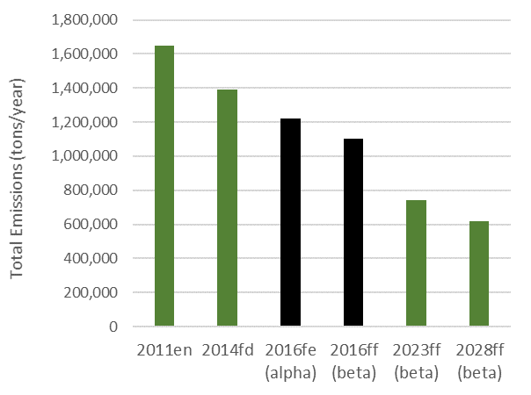
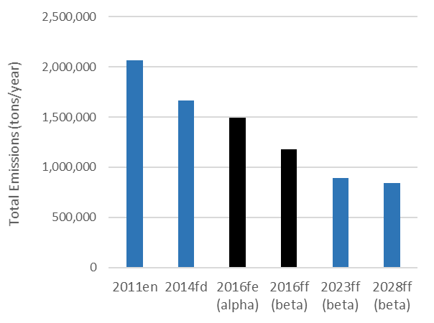
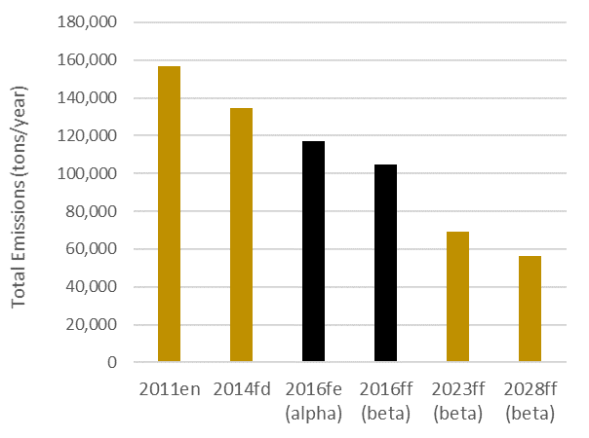
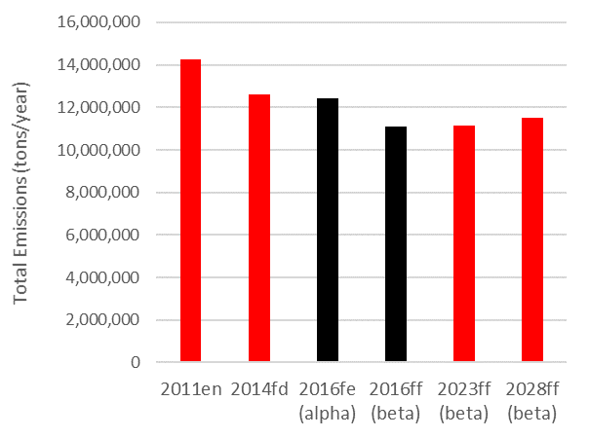
Nonroad Workgroup: 2016 beta summary
Nonroad NOx
Nonroad VOC
Nonroad Sector Emissions: Platform Comparison
Nonroad PM2.5
Nonroad CO
Data Source: http://vibe.cira.colostate.edu/iwdwx/Emissions/2016EMP

Slide 64
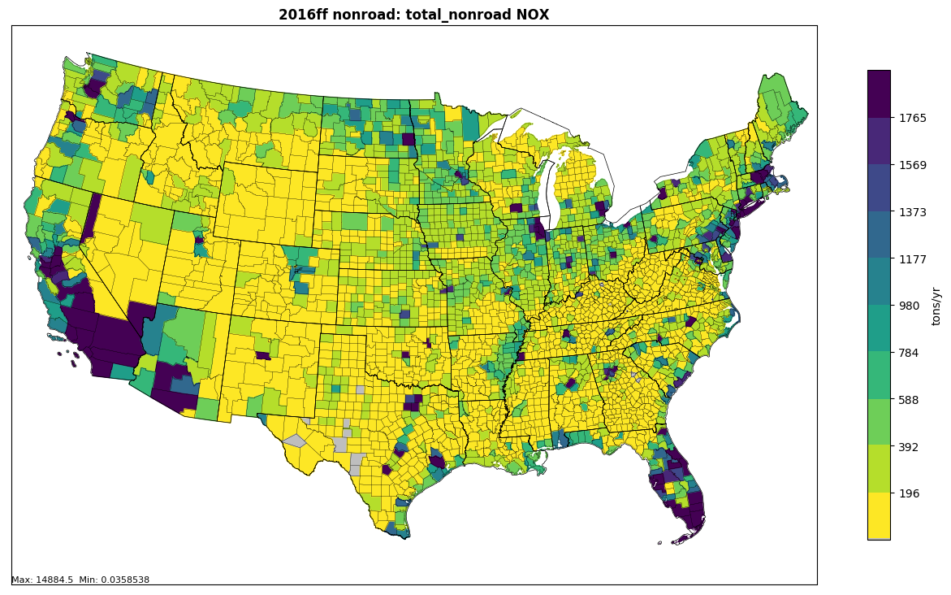
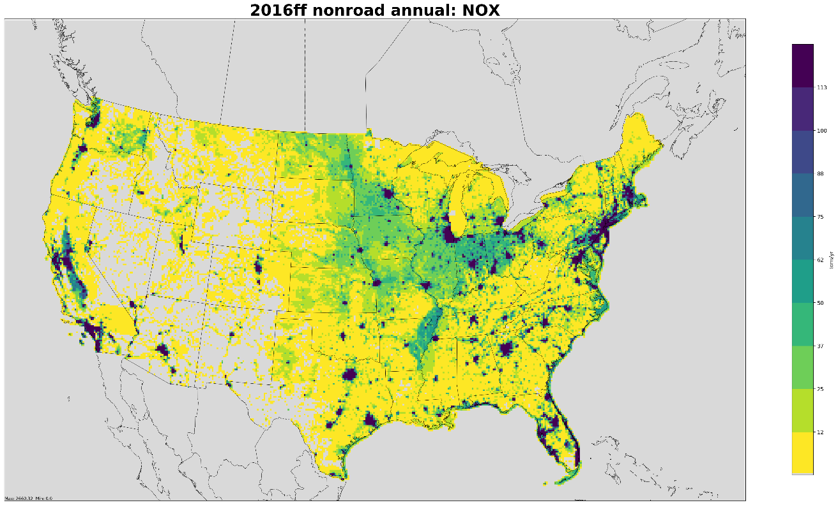
Nonroad Workgroup: 2016 beta summary
County-level NOx inventories (all nonroad equipment sectors)
12-km gridded data used for modeling

Slide 65
Nonroad Workgroup: 2016v1
Approach
  MOVES2014b with state-supplied data and updated factors for allocating Agricultural and Construction equipment
  EPA currently compiling and reviewing data supplied by states for 2016 v1 and 2017 NEI
Differences from beta
  Updated geographic allocations for Construction and Agricultural equipment sectors
  Nonroad Workgroup currently reviewing results from testing new allocation factors
Milestones
  Expected review date: June 2019
  Expected release date: July 2019

Slide 66

Rail Workgroup
Lead Mark Janssen (LADCO)
Schedule: Calls 3rd Thursday at 11:00am ET
Wiki: http://views.cira.colostate.edu/wiki/wiki/9182

Slide 67
Rail Workgroup: 2016 Beta
Approach
  FRA link level calculation for Line haul.
  Yards, Eastern railroads use Google earth to identify switching engines.
  Includes passenger rail from AMTRAK for the first time
  Includes the larger diesel passenger services in major metro areas (Metra, MBTA, etc)
  Direct to FF10 in spreadsheets and calculation tools.
  Removed 150+ unswitched yards from 2014 estimates

Slide 68
Rail Workgroup: 2016v1
Approach
  Updates to Beta from states (yards, class 2/3 fuel use)
  Include better growth estimates of fleet technology
Differences from beta
  Only what states submit.
Milestones
  Expected review date: May 2019
  Expected release date: June 2019

Slide 69
Rail Workgroup: 2016v1
Projections:
  Have very low growth rates <5% by 2023.
  Last EPA projection of future technology done by OTAQ in 2008.
    New engines not entering fleet as quickly as expected. Will need improvement

Slide 71

Commercial Marine Vessel (CMV) Workgroup
Lead Mark Janssen (LADCO)
Schedule: Calls on 3rd Tuesday at 3:00pm Eastern; WG is currently not meeting
Wiki: http://views.cira.colostate.edu/wiki/wiki/9176

Slide 72
Marine Workgroup: 2016 Beta and v1
Approach for beta
  Project 2014NEIv2 to 2016, 2023, 2028 based on fuel usage and accounting for post 2014 regulations
Approach for v1
  Backcast 2017 NEI to 2016.
  2017 NEI based on new power model and AIS data
  Won’t have data needed to calculate 2016 directly (proprietary vessel data) and EPA does not have resources to help with this right now
  Need a summary of 2017 emission rates by vessel type to proceed

Slide 73
Marine Workgroup: 2016 Beta and v1
V1 Differences from beta
  Base year was 2014 without AIS; v1 will be based on 2017 AIS
  Projection Years (2023 & 2028): will include updated forecasts from EIA.
Milestones
  Expected review date: June 2019
  Expected release date: Summer 2019
  Work may continue after version 1 if EPA can release summary data.

Slide 74

Fires Workgroup
Co-leads: Jeff Vukovich (EPA) and need volunteer for a new co-lead from outside EPA
Schedule: Calls on 1st Thursday 1PM ET
Wiki: http://views.cira.colostate.edu/wiki/wiki/9175
Includes wildfires, prescribed fires and agricultural burns

Slide 75

Fire Emissions Processing at High-Level
2016 beta

Slide 76
National totals comparison

Slide 77





Final 2016 beta national totals
Emissions in thousands of tons

Slide 78


Historical perspective:
Fires
* includes AK fires

Slide 79
International Fire Inventory for 2016beta (ptfire_othna)
Fire Inventory from NCAR (FINN) global dataset
  Used for Mexico and first 3 months of year in Canada
Environment Canada Inventory
  Year 2016 inventory (April-December)
  Used FINN to fill in missing time periods
  Fort McMurray fire (1.5M acres; May-Aug)
    Otherwise a quiet year

Slide 80
Fires: 2016v1
Approach
  Quality assure 2016beta and make improvements where possible
  Incorporate more national and state agency fire information datasets
  Respond to any comments provided by May 31st
Differences from beta
  Base Year (2016): Incorporate national fire datasets
    Forest Service Activity Tracking System (FACTS) data from the USFS-USDA
    National Fire Plan Operations and Reporting System (NFPORS) database from Dept of Interior
    Any state-submitted and other changes (NJ, KS, NC, CA)
  Possible alternative fire scenarios for future year modeling?
Milestones
  Expected review date: June 30 2019
  Expected release date: Summer 2019

Slide 81

Biogenic Workgroup
Co-leads: Doug Boyer (TCEQ), Jeff Vukovich (EPA)
Schedule: Calls on 3rd Tuesday at 3:30pm Eastern
Wiki: http://views.cira.colostate.edu/wiki/wiki/9172

Slide 82
Biogenics: 2016beta summary
2016 alpha consisted only of a BEISv3.61 simulation
MEGANv3 software made available by TCEQ
TCEQ acquired 2016 MCIP data from USEPA
TCEQ ran MEGANv3 for 2016 using MCIP data
Workgroup did some comparisons vs. BEIS3
Minor water correction made to BELD4 and BEIS3 rerun
BEIS3 (water correction) and MEGANv3 “default” simulations made available for 2016 beta release

Slide 83

2016beta: BELD4 Water fix

Slide 84


2016beta: Landuse comparisons

Slide 85

MEGAN vs. BEIS3 emissions: July ISOP

Slide 86

MEGAN vs. BEIS3 emissions: July Nitric Oxide

Slide 87
Biogenic Workgroup: 2016v1
Approach
  Investigate input data improvements and software/science updates; respond to any comments that are due by May 31
  Looking for air quality model evaluation results (one run with BEIS3 and one with MEGAN comparison)
Differences from beta
  Base Year (2016): possibilities include:
    Environment Canada BELD4 landuse implementation
    Arizona landuse update
    No MEGANv3 updates planned
    Possible emissions flux observation comparions for summer of 2013
  Projection Years (2023 & 2028): N/A
Milestones
  Expected review date: June 2019
  Expected release date: Summer 2019

Slide 88
Emissions Modeling Workgroup
Co-leads: Eric Zalewsky (NY DEC), Zac Adelman (LADCO)
Schedule: Calls on 4th Thursday at 3:00pm Eastern
Wiki: http://views.cira.colostate.edu/wiki/wiki/9190

Slide 89
Emissions Modeling Workgroup
Scope: To test and help document the emissions modeling platform
  EPA OAQPS will build the beta and v1 modeling platforms
  Workgroup will beta test the platform scripts and release package, document how to change the platform
Standardized plots available @ LADCO
Interactive plotting tool available @ IWDW

Slide 90
Emissions Modeling Workgroup
2016beta work to date
  Reviewed and edited inventory WG documentation
  Created summary plots of the 2016beta emissions
  Testing the 2016beta platform EPA processing scripts

Slide 91
Emissions Modeling Workgroup
Plans for the next quarter
  Detailed analysis of the 2016beta emissions: comparison to past EMPs (2011 and 2014), evaluate ancillary data
  Document how to modify the platform: new modeling domains and different emissions data
  Process new modeling domains and conduct air quality modeling/analysis
  Collaborate with EPA OAQPS on 2016beta air quality model performance evaluation
  Process future year inventories (2023 & 2028)
  Compare 2016v1 and 2016 beta emissions

Slide 92
International Emissions
Mexico
  Beta emissions are the same as those in the alpha platform but we hope to have some improvements in time for 2016 v1 via a collaboration with SEMARNAT
Canada
  Beta emissions use a new 2015 inventory from Environment and Climate Change Canada
  A corresponding future year inventory may be available for use this month
  We hope that a consistent future year inventory will become available before 2016v1 is finalized

Slide 93
Meteorology and Air Quality Modeling
Emissions and other inputs to the air quality model will be made available via the IWDW
  EPA will share its 2016 meteorological input data for air quality modeling with the IWDW
EPA will be modeling the 2016 beta base year with CAMx and CMAQ
  2028beta will be modeled this summer
  EPA does not currently plan to model 2023beta

Slide 94
Inventory Collaborative Next Steps
Workgroups will be prioritizing their work to produce version 1.0 of the 2016 inventory by summer 2019; including projections to 2023 and 2028
Collecting information on prospective uses of the alpha and beta platforms: let us know
Quarterly outreach calls by the Collaborative to report out on progress: mark your calendar
Next outreach call:
June 26, 2019 at 12:00 Eastern

Slide 95
Inventory Collaborative Wiki
These slides, answers to the questions posed during this webinar, notes:
http://views.cira.colostate.edu/wiki/wiki/10198
Main National Inventory Collaborative Wiki includes live workgroup wikis, documentation, calendar:
http://views.cira.colostate.edu/wiki/wiki/9169

